Slide 1
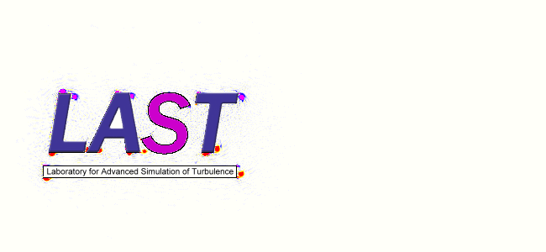
基于通量重构方法的 高精度湍流模拟研究
博士研究生：朱辉
指导教师：符松 教授
2017.5

Slide 2
目录
绪论
通量重构方法
高精度隐式大涡模拟研究
前台阶转捩流动研究
结论与展望

Slide 3
1.绪论

Slide 4
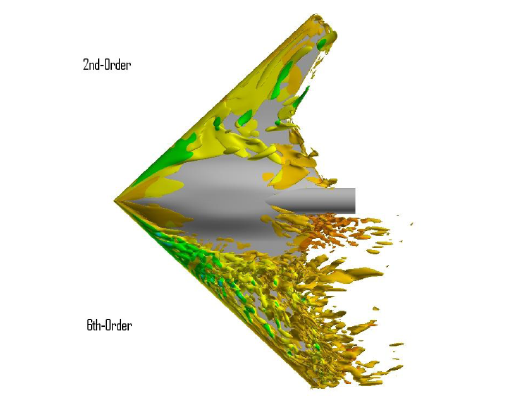
从“LAST”谈起
Laboratory for Advanced Simulation of Turbulence
传统湍流模拟
传统湍流模拟方法：RANS
传统数值方法：二阶有限体积法/ 多块结构网格
先进湍流模拟
精细湍流模拟方法：DES/ LES/ DNS
新型数值方法：高分辨率格式/ 高精度方法/ 非结构网格

Slide 5
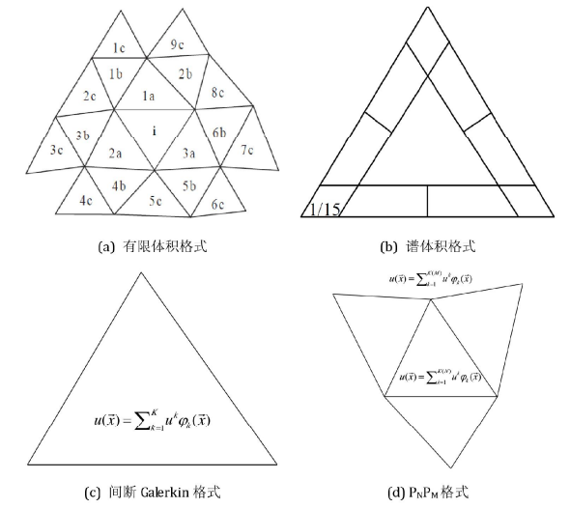
高精度数值方法
实现高精度的关键
单元内多项式分布
通量/守恒量积分点
一般原则：
精度=多项式次数+1
积分精度与求解精度匹配
多项式表达
基函数+DOF
Modal：正交多项式基，DOF物理意义不明确
Nodal：Lagrange多项式基，DOF就是节点的值
李万爱，博士论文，《非结构网格高精度数值方法的若干问题研究》

Slide 6
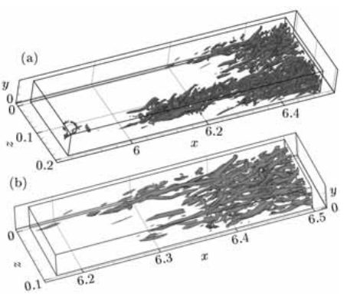
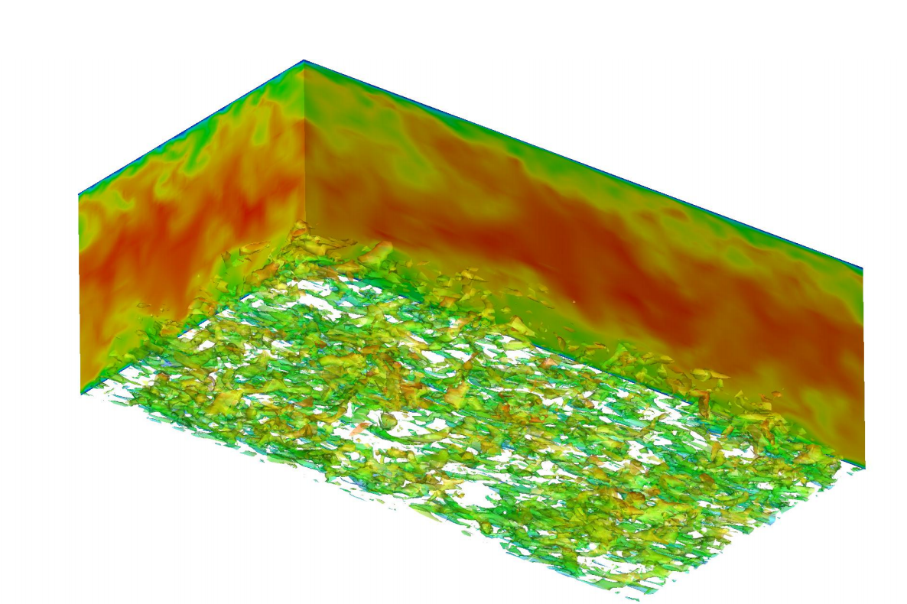
高精度精细湍流模拟（1）
直接数值模拟（DNS）
高精度有限差分
Li. et. al. 高超声速边界层
简单外形
低雷诺数
大涡模拟
Nagarajan 紧致有限差分
Toro ADER
壁面处理
Li XL, Fu DX, Ma YW. Direct numerical simulation of a spatially evolving supersonic turbulent boundary layer at Ma= 6
Nagarajan S, Lele S K, Ferziger J H. A robust high-order compact method for large eddy simulation Titarev V A, Toro E F. ADER schemes for three-dimensional non-linear hyperbolic systems.
Notes:
李新亮，高超声速DNS
Paul Tucker, 高阶LES

Slide 7
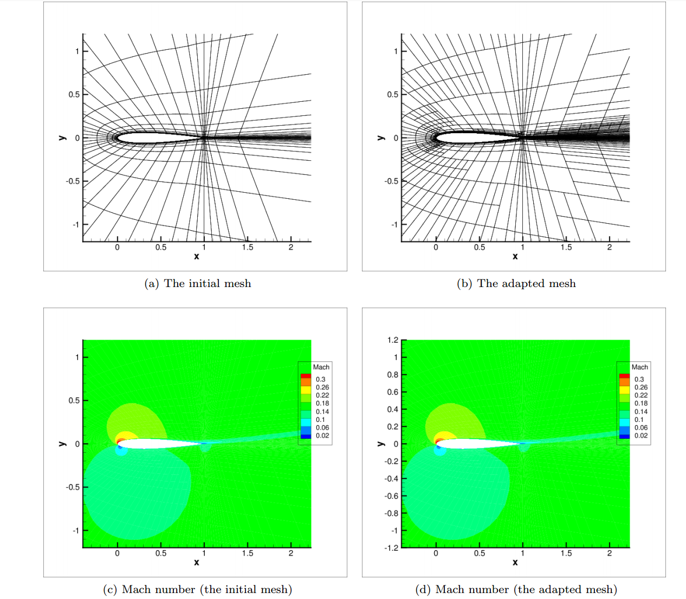
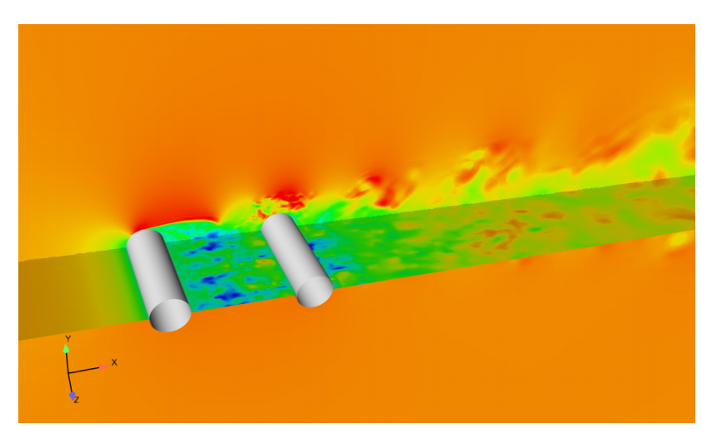
高精度精细湍流模拟（2）
雷诺平均（RANS）& 脱体涡模拟（DES）
数值刚性
实现技巧
“一维线搜索”
自适应网格
人工粘性/限制器
Gao J, Li X. Numerical Simulation of the Noise from Tandem Cylinder Flow with Spectral Difference Method
Shi L, Zhou C, Wang Z J. Adaptive RANS Solution with the High-order Correction Procedure via Reconstruction Method
Notes:
北航李晓东DES
周成2D SA

Slide 8
研究目标
基于高精度通量重构的大涡模拟
隐式大涡模拟
基于高精度隐式大涡模拟的壁面模型
如何克服数值刚性问题？
如何避免对数区偏差？
高精度通量重构方法在流动转捩问题上的应用
前台阶转捩流动

Slide 9
2.通量重构方法

Slide 10
通量重构方法（FR/CPR）
Flux Reconstruction
也称为Correction Procedure via Reconstruction
Huynh 2007
节点型有限单元法 (Nodal FEM)
单元内多自由度
无显式数值积分
统一框架
不同的修正系数对应了不同的高阶方法

Slide 11
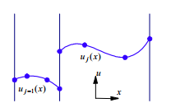
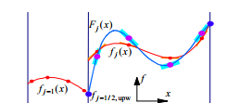
通量重构方法（FR/CPR）
Solution Points & Flux Points
重构
利用Solution Points上的值重构出多项式分布
单元界面：
类似FVM，用Riemann Solver算连续通量
修正
利用单元界面的连续通量修正多项式

Slide 12
数学形式
最终形式：在每个单元内
微分形式，避免了数值积分，比DG省计算量
每个单元仅受到相邻单元影响，数值格式是紧致的，边界条件实施较简单，容易并行化

Slide 13
粘性项的计算: BR2格式
简单处理 = “危险的”非物理解
本单元梯度也需要修正过程，否则不守恒
边界处梯度不能直接平均！(Cockburn & Shu 1998)
尽可能紧致！
Bassi-Rebay 2格式
Bassi & Rebay (2000), for DG
Huynh (2009): “翻译”到CPR框架下

Slide 14
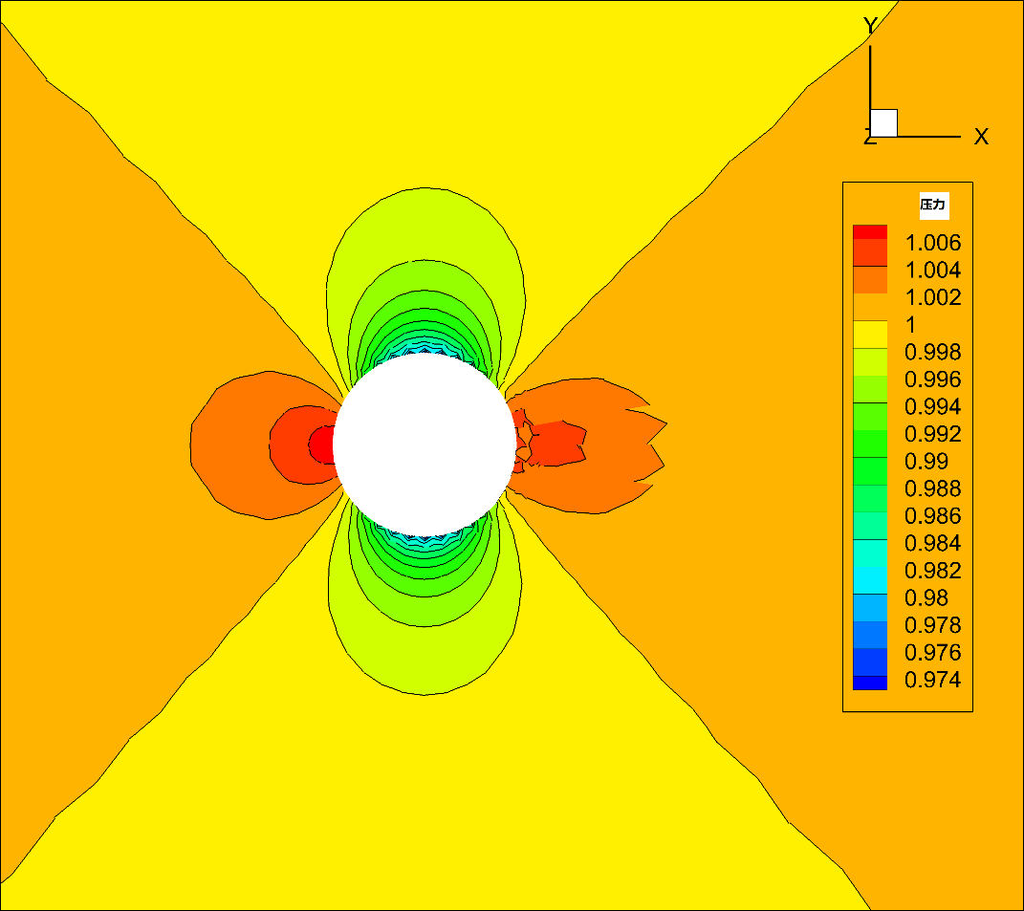
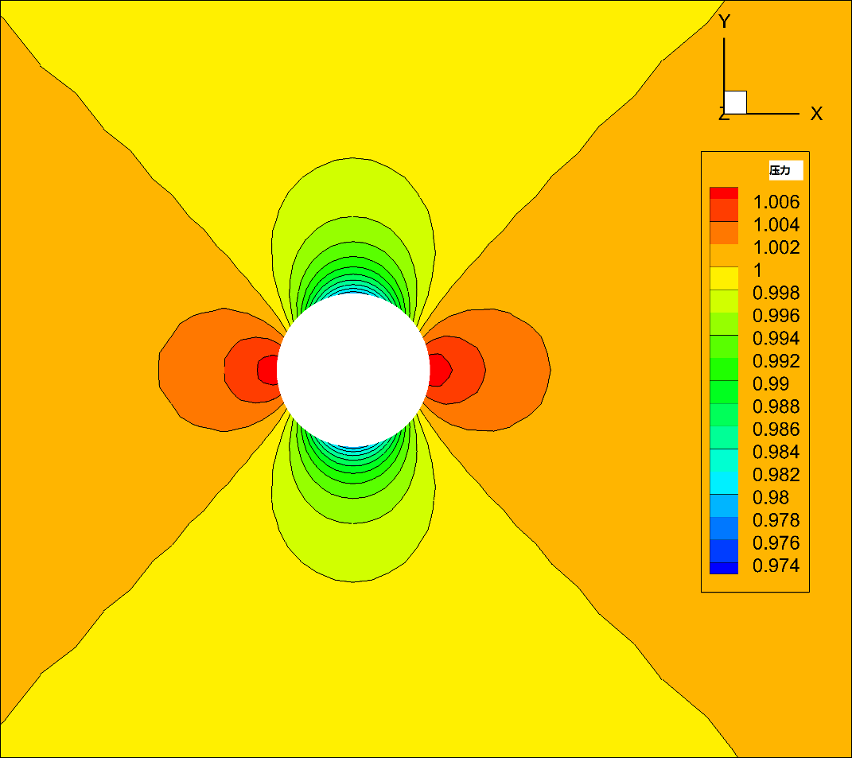
曲边网格处理
直边网格
网格稀疏
法向量、面积等误差
曲边网格修正

Slide 15
计算程序MUSIC
多物理场模拟程序
Multiphysics Simulation Code
基于通量重构方法
原始版本由ZJ Wang教授课题组开发
现代化程序
采用C++编写，使用Petsc等第三方库
预留多物理场求解接口
并行计算
MPI，支持大规模并行（目前最多使用2000进程并行）
新型数值方法
hp adaptation

Slide 16
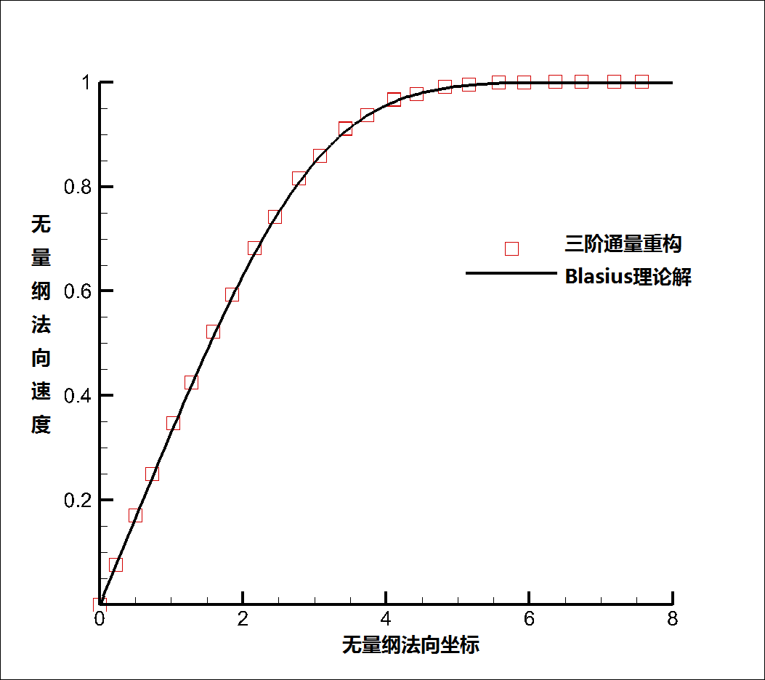
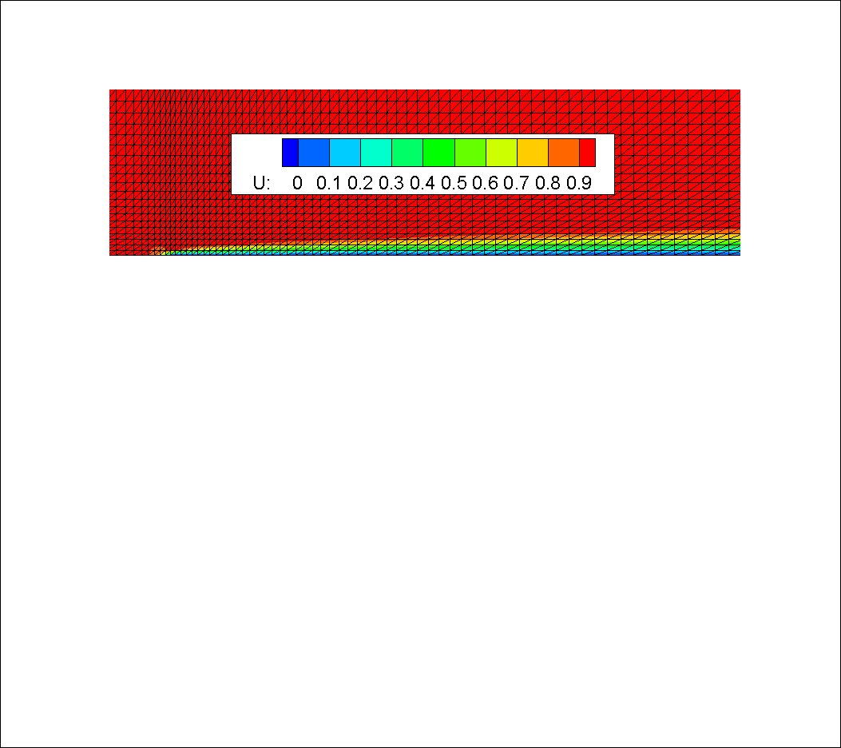
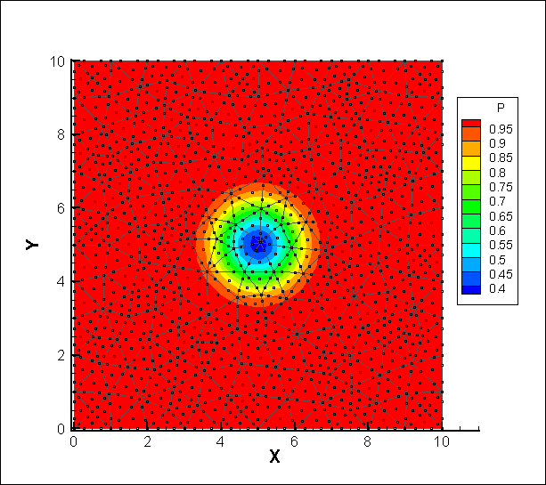
测试算例
Theoretical Order | Grid Size | L2 Error | Actual Order
2 | 10*10 | 3.060e-2 | -
 | 20*20 | 7.295e-3 | 2.07
 | 40*40 | 1.933e-3 | 1.99
3 | 10*10 | 7.406e-3 | -
 | 20*20 | 1.032e-3 | 2.84
 | 40*40 | 1.385e-4 | 2.87
4 | 10*10 | 1.358e-3 | -
 | 20*20 | 1.028e-4 | 3.72
 | 40*40 | 7.330e-6 | 3.77

Slide 17
3.高精度隐式大涡模拟研究

Slide 18
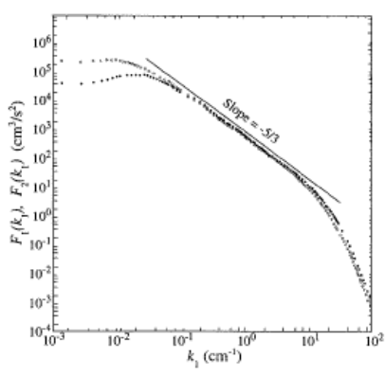
Large Eddy Simulation
基本思想&原理
“过滤”
解析大尺度，模化小尺度
存在普适的频谱性质
可能存在普适的模型
常见模型
Static Smagorinsky
Dynamic Smagorinsky
Scale Similarity
Mixing Model = Smagorinsky + Scale Similarity
Implicit LES

Slide 19
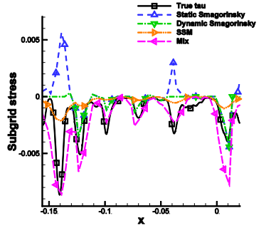
Smagorinsky模型的缺陷
基于混合长假设
缺乏物理基础
纯耗散性
“可实现性”
壁面极限SGS应力不等于零
对于高阶格式，Implicit LES可能优于Smagorinsky
Li and Wang 2015
隐式大涡模拟具有潜力
Li Y, Wang Z J. A priori and a posteriori evaluations of sub-grid scale models for the Burgers’ equation
Notes:
可实现性:亚格子k>0，实际上有更严格的要求

Slide 20
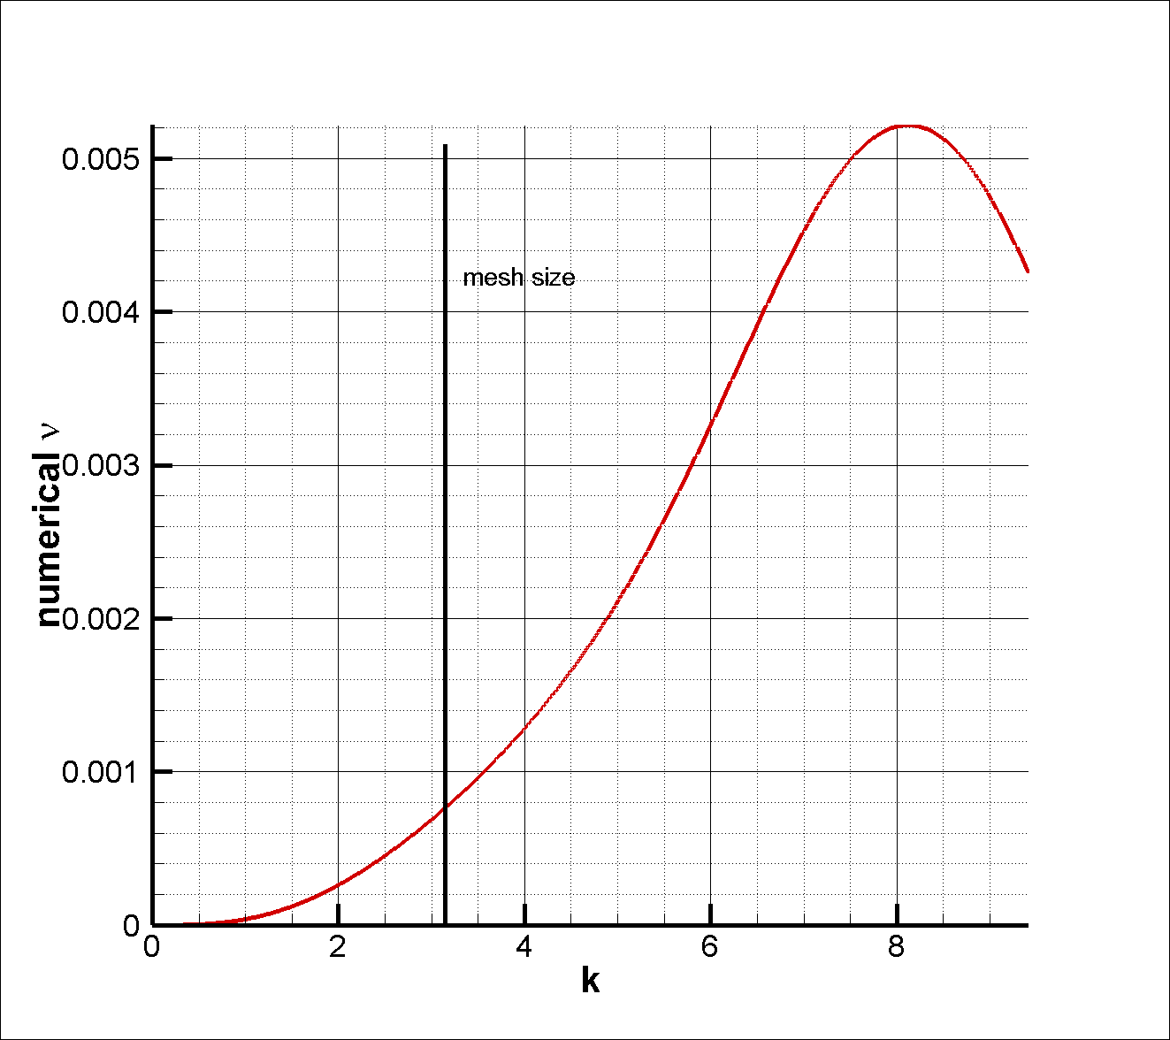
基于通量重构的隐式大涡模拟
以三阶通量重构方法为例（定性分析）
由格式线性分析得出
假设网格尺度处于惯性子区
小于网格尺度时，等效粘性系数随波数增加升高
Domaradzki J A, Xiao Z, Smolarkiewicz P K. Effective eddy viscosities
in implicit large eddy simulations of turbulent flows

Slide 21
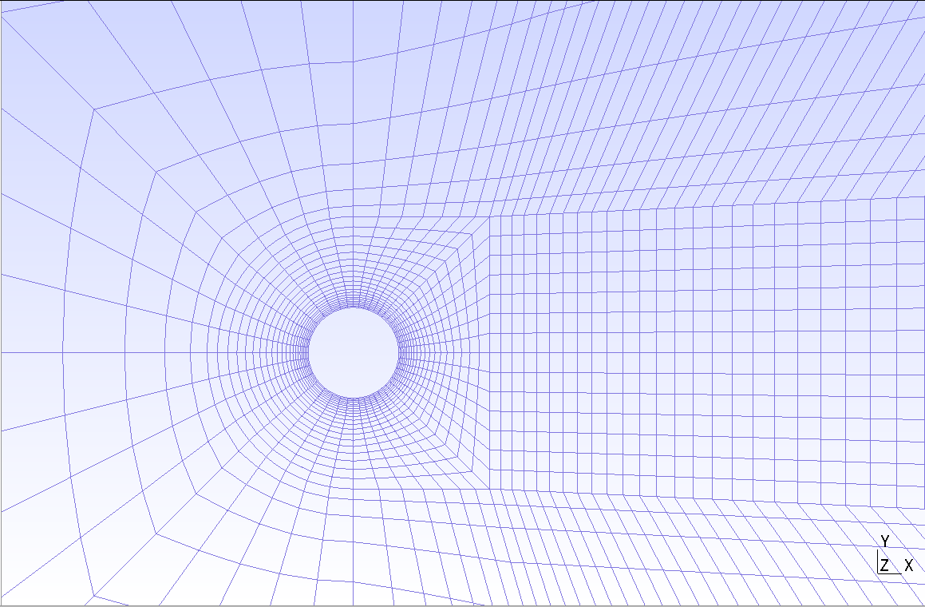
Cylinder at Re_{D}=3900 (1)
亚临界雷诺数
层流边界层+湍流尾迹
P3曲边网格
53,910单元数
展向15层
三阶/四阶通量重构
隐式大涡模拟
初始条件：
均匀场 + 非对称光滑扰动

Slide 22
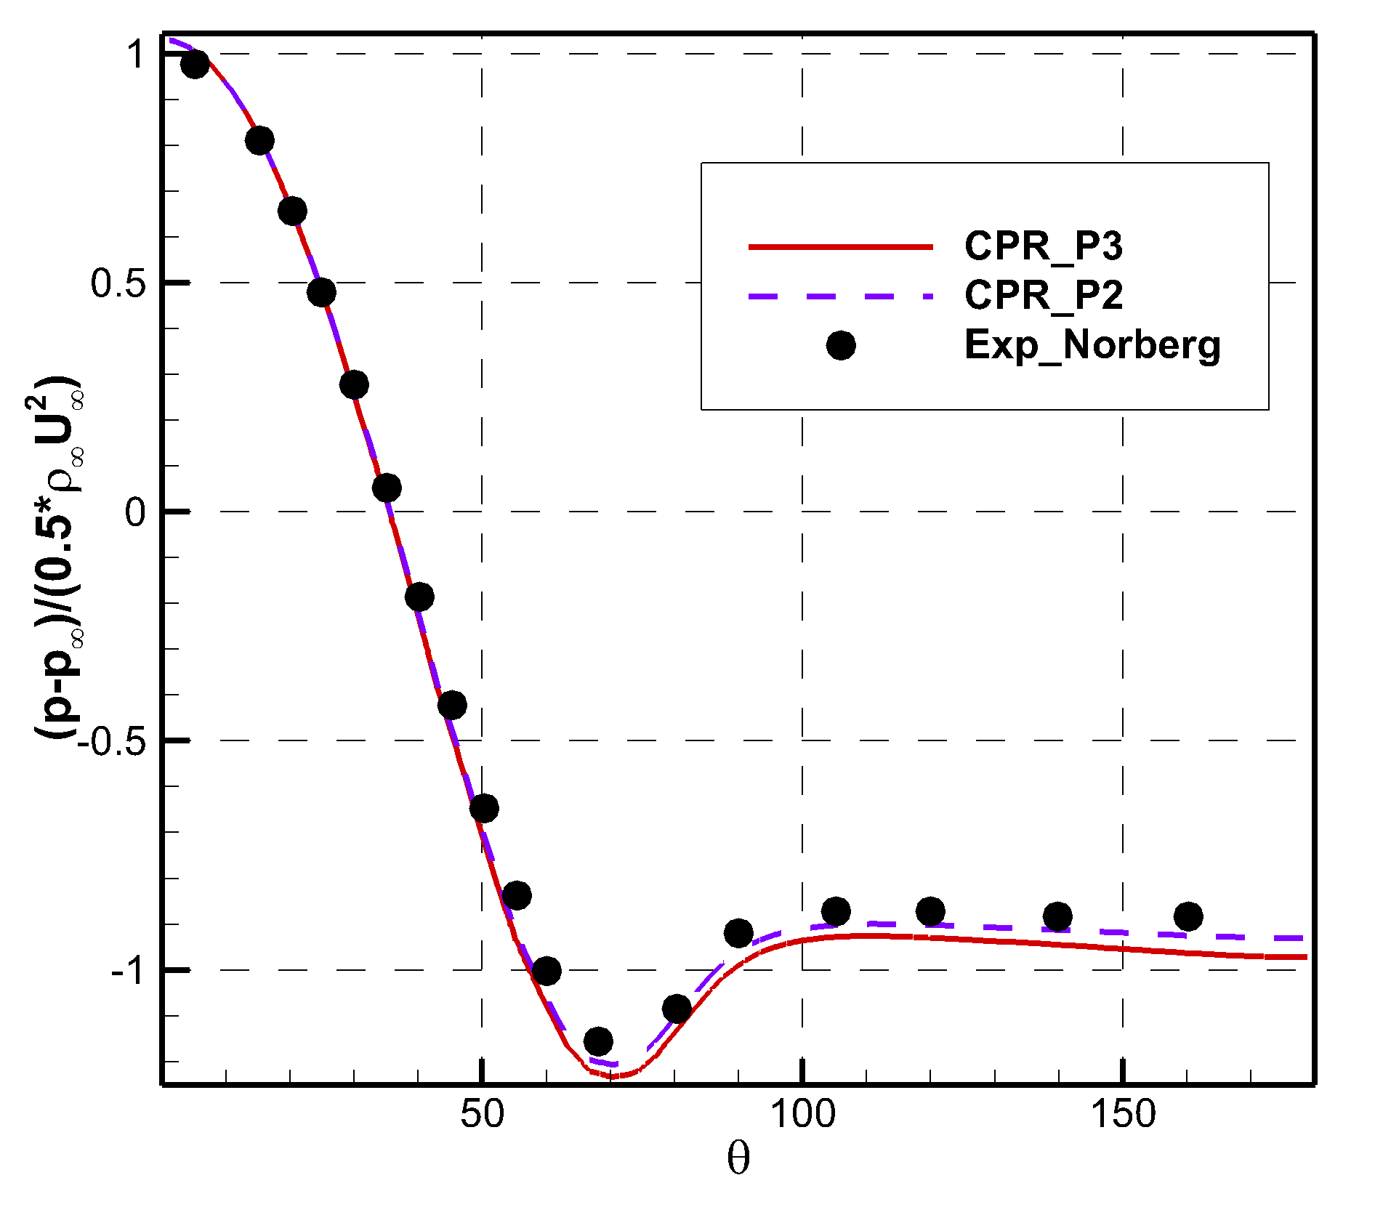
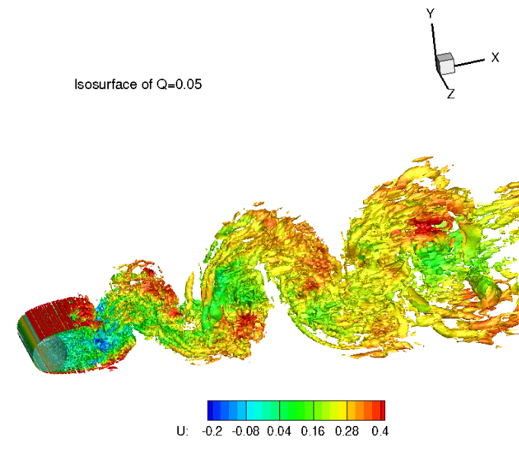
Cylinder at Re_{D}=3900 (2)
壁面压力分布
三阶、四阶均与实验符合良好

Slide 23
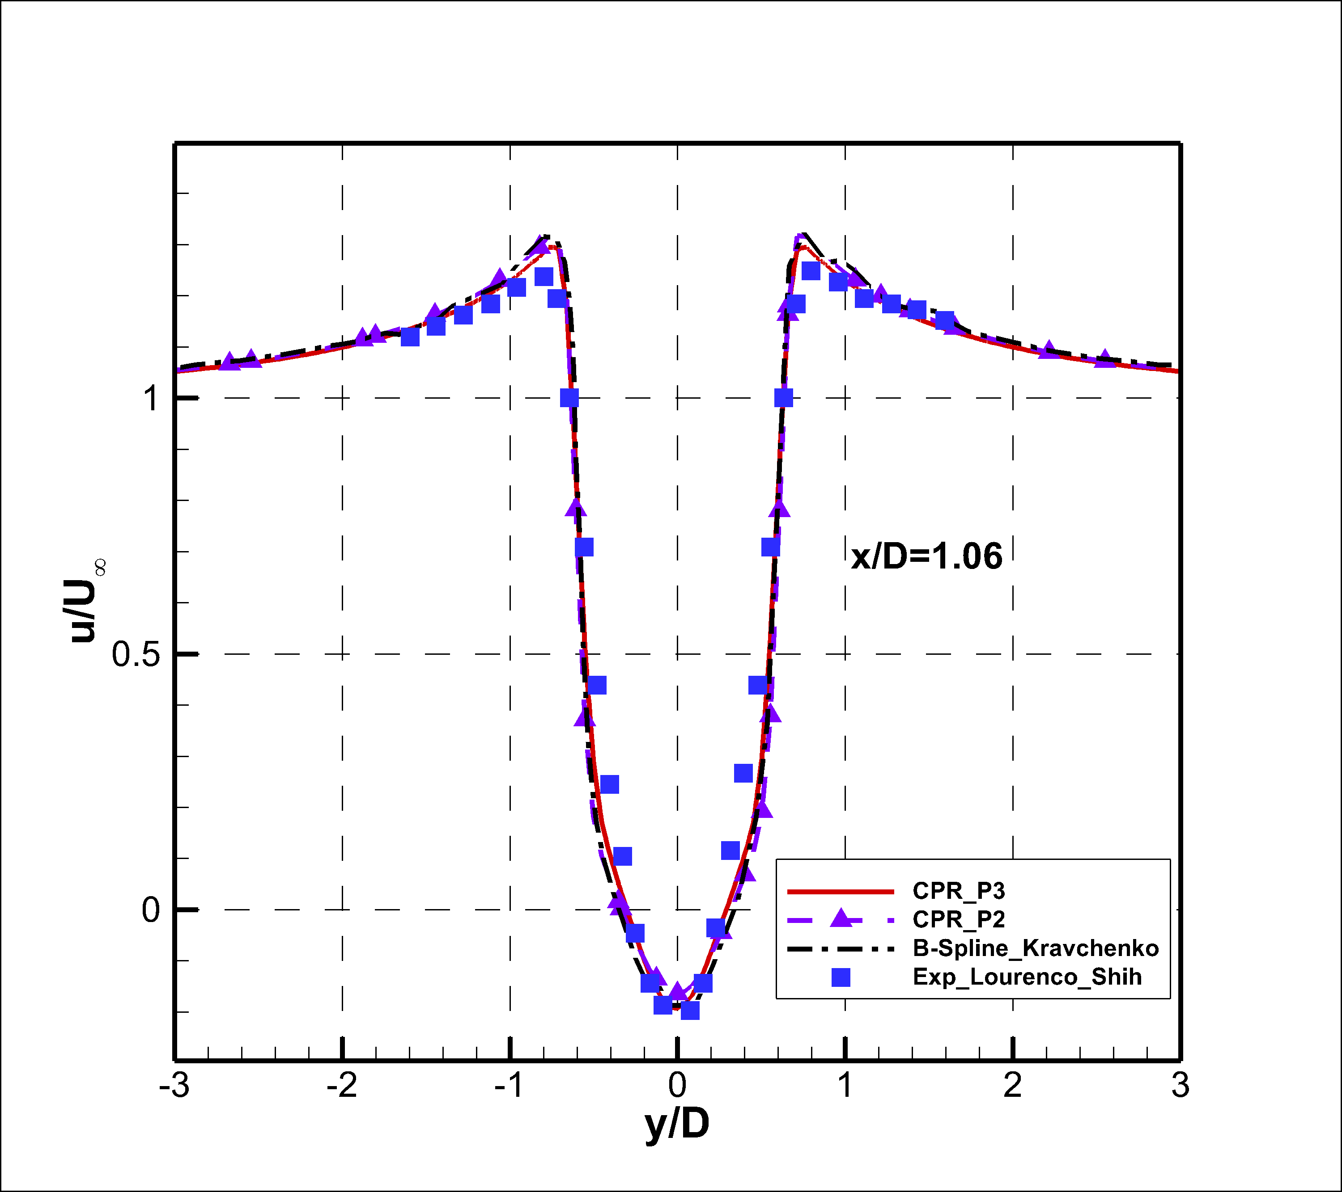
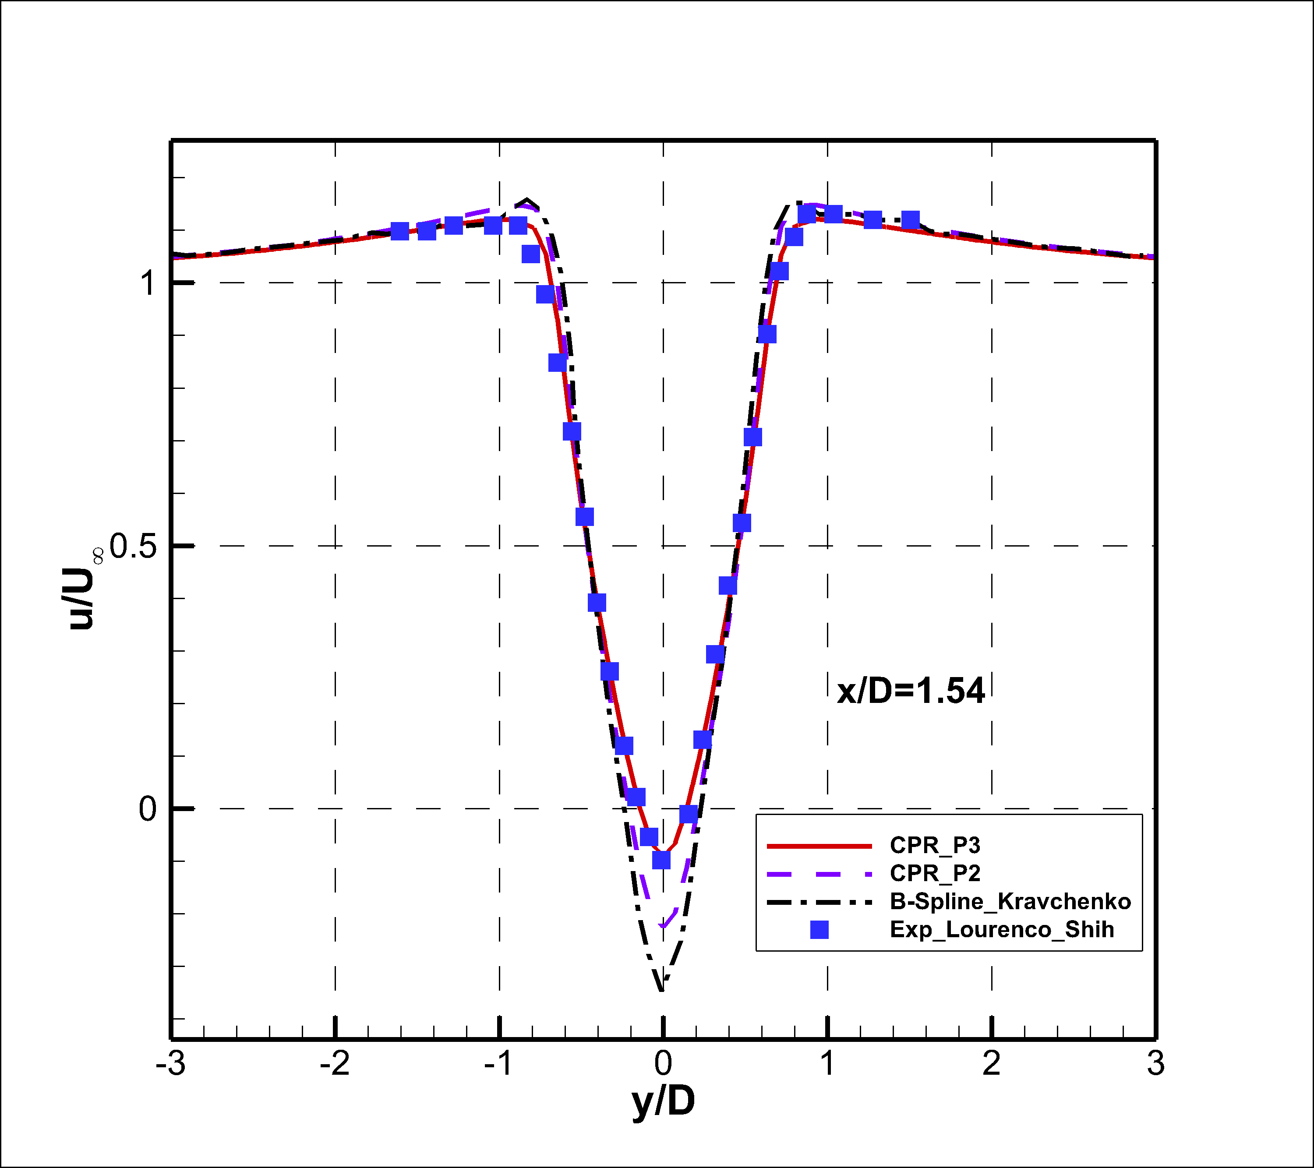
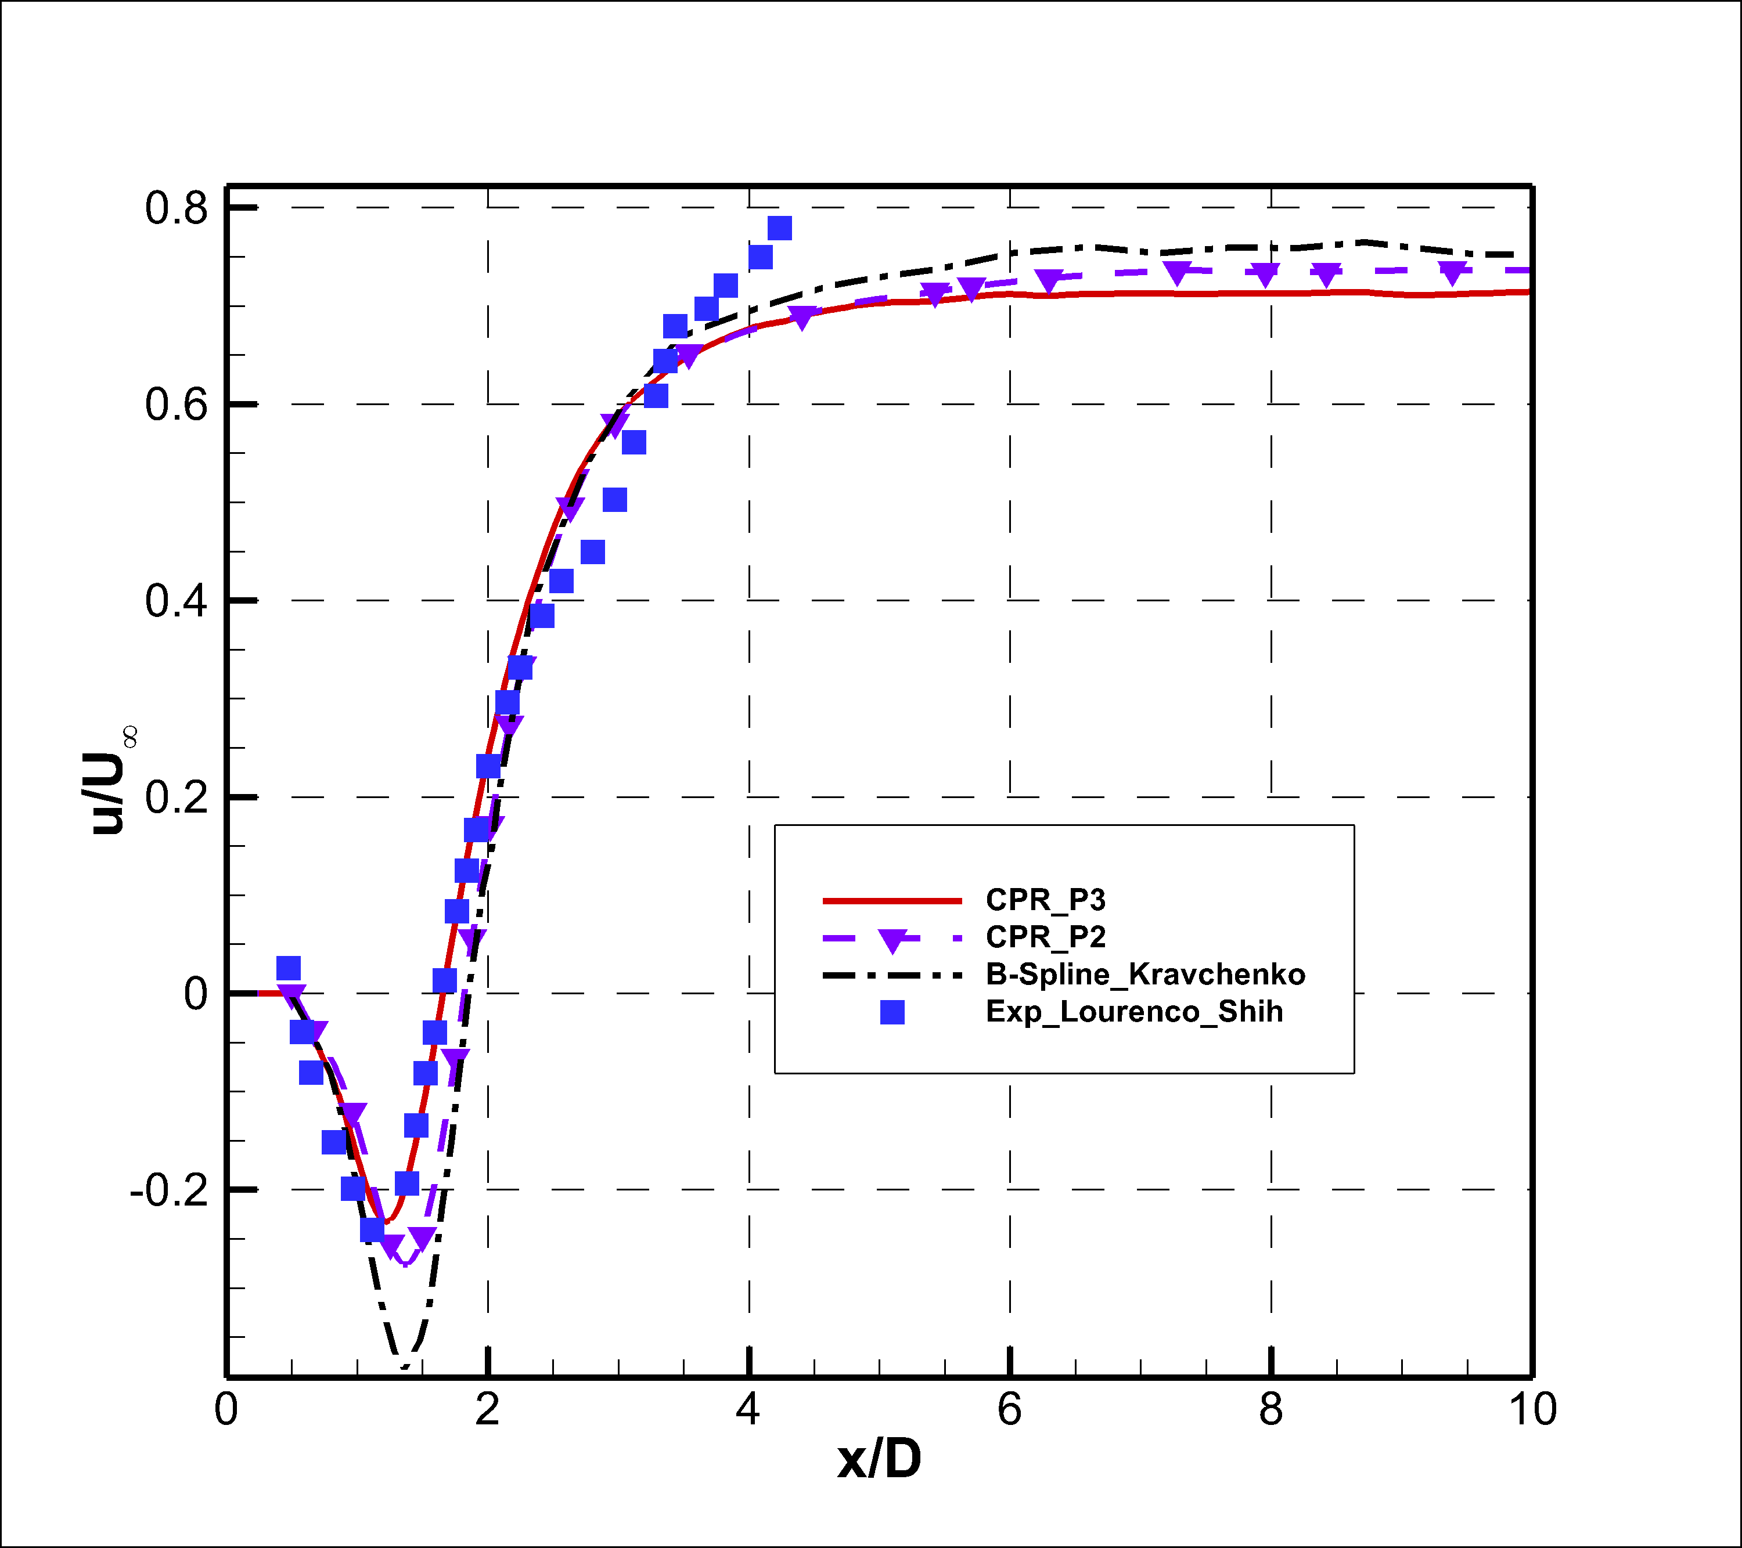
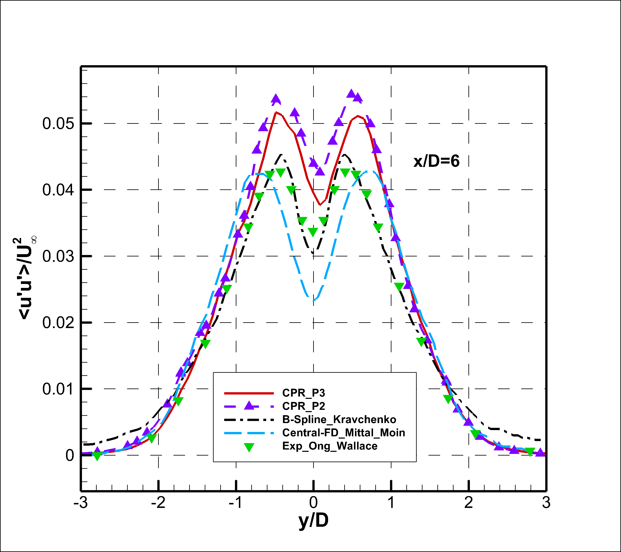
Cylinder at Re_{D}=3900 (3)

Slide 24
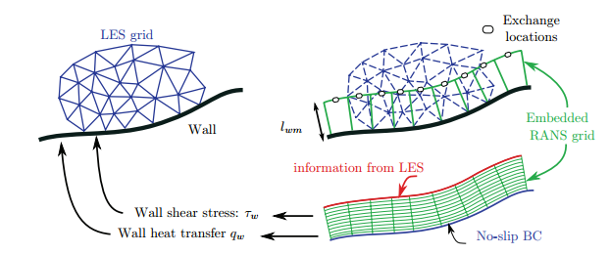
Wall Modelled LES
降低壁面附近的网格量需求
三种常见策略
改变边界条件：用切应力边界代替无滑移边界 (不稳定)
嵌套网格：在壁面附近求解RANS方程 (复杂)
涡粘模式：在壁面附近引入RANS涡粘系数 (✔）

Slide 25
新型壁面模型设计目标
不求解湍流模式方程
数值刚性
远离壁面区域变为隐式大涡模拟
降低壁面附近流向&展向网格需求
法向网格仍要求较密，以保持数值稳定
尽可能只使用“当地变量”
避免对数区不匹配

Slide 26
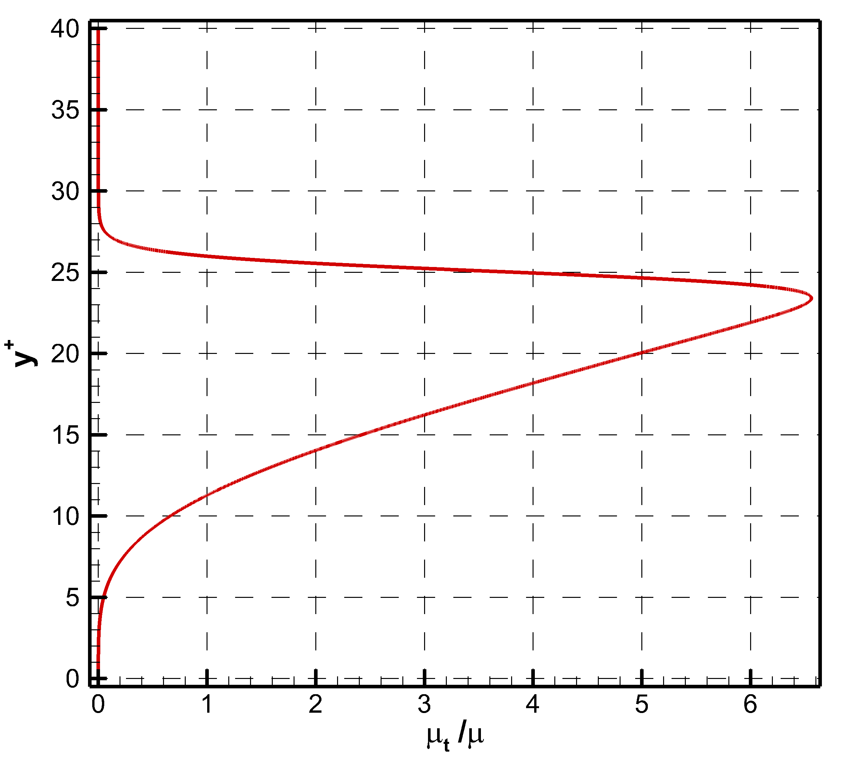
S-A模式的近壁代数近似
Durbin 2004
粘性底层
f_{v1}分母趋于常数
f_{v1}整体正比于y⁺的三次方
涡粘系数正比于y⁺的四次方
对数区
f_{v1}整体趋于1
涡粘系数正比于y⁺

Slide 27
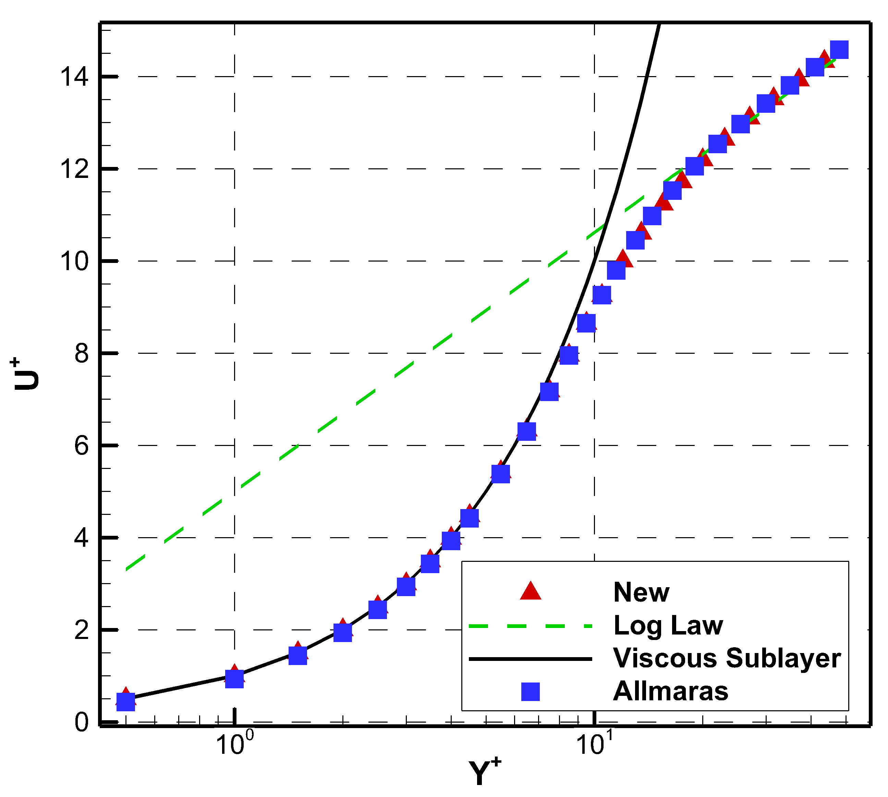
Y⁺的计算
湍流边界层尺度定义
等应力层假设（零压梯度）
代入上述代数涡粘模式，积分此方程

Slide 28
新型壁面模型计算过程
在壁面第一层网格内
取采样点计算
目前取离壁面最远的求解点
根据u⁺和y⁺关系式求解y⁺
Ridder’s算法，5到10步即可收敛
将y⁺插值到第一层网格内所有的求解点和通量点
网格类型已知，求解点和通量点位置已知
若对涡粘系数直接插值，易产生数值不稳定
判断最大y⁺
若大于30，计算完成；否则在法向下一层网格中继续计算

Slide 29
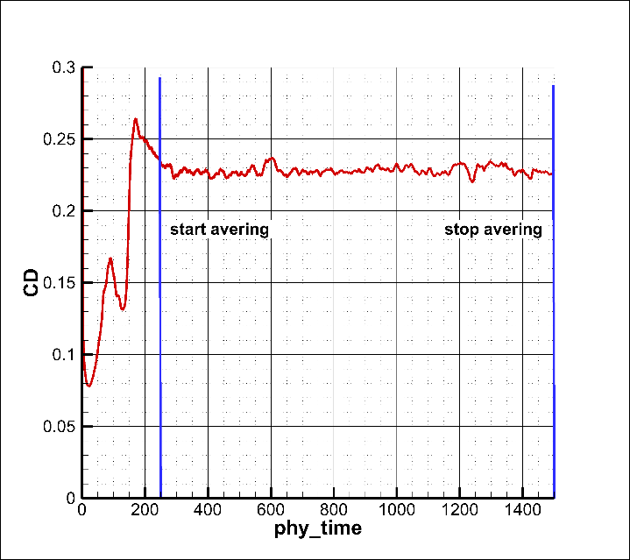
槽道湍流(1)
三个不同雷诺数
Re_{τ}= 395, 640, 1140
不同网格
流向、展向不同网格密度&法向网格分布
算例 | 名义Re_{τ} | N_{x}×N_{y}×N_{z} | 第一层网格y⁺ | 第一个求解点y⁺ | 使用壁面模型
Case1 | 640 | 16×24×16 | 12 | 0.833 | 否
Case2 | 640 | 32×24×32 | 12 | 0.833 | 否
Case3 | 395 | 16×24×16 | 12 | 0.833 | 是
Case4 | 640 | 16×24×16 | 12 | 0.833 | 是
Case5 | 1140 | 16×24×16 | 12 | 0.833 | 是
Case6 | 640 | 16×24×16 | 8 | 0.556 | 是
Case7 | 640 | 32×24×32 | 12 | 0.833 | 是

Slide 30
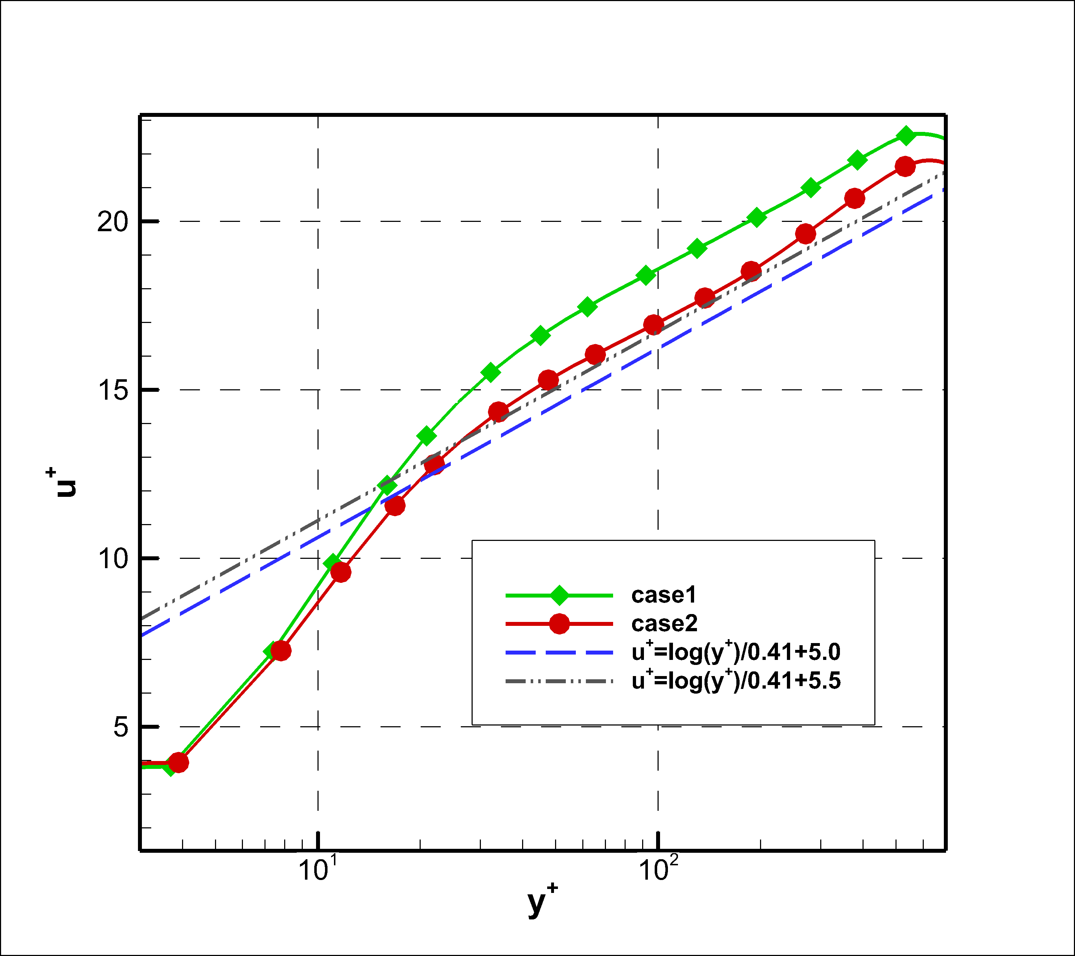
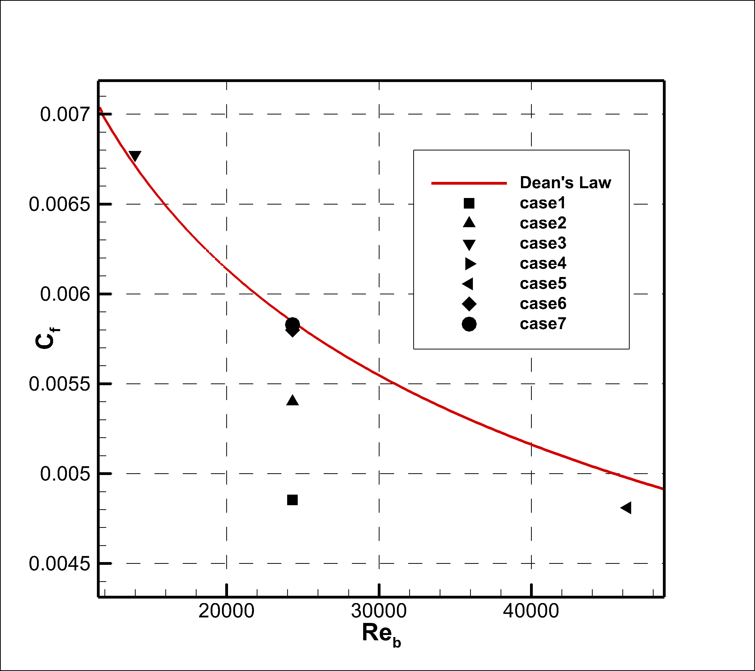
槽道湍流(2)
如果不使用壁面模型：case 1, 2
稀网格x⁺=50：速度型偏差，摩阻系数偏低20%
加密到x⁺=25：稍有改善，但摩阻系数仍偏低10%

Slide 31
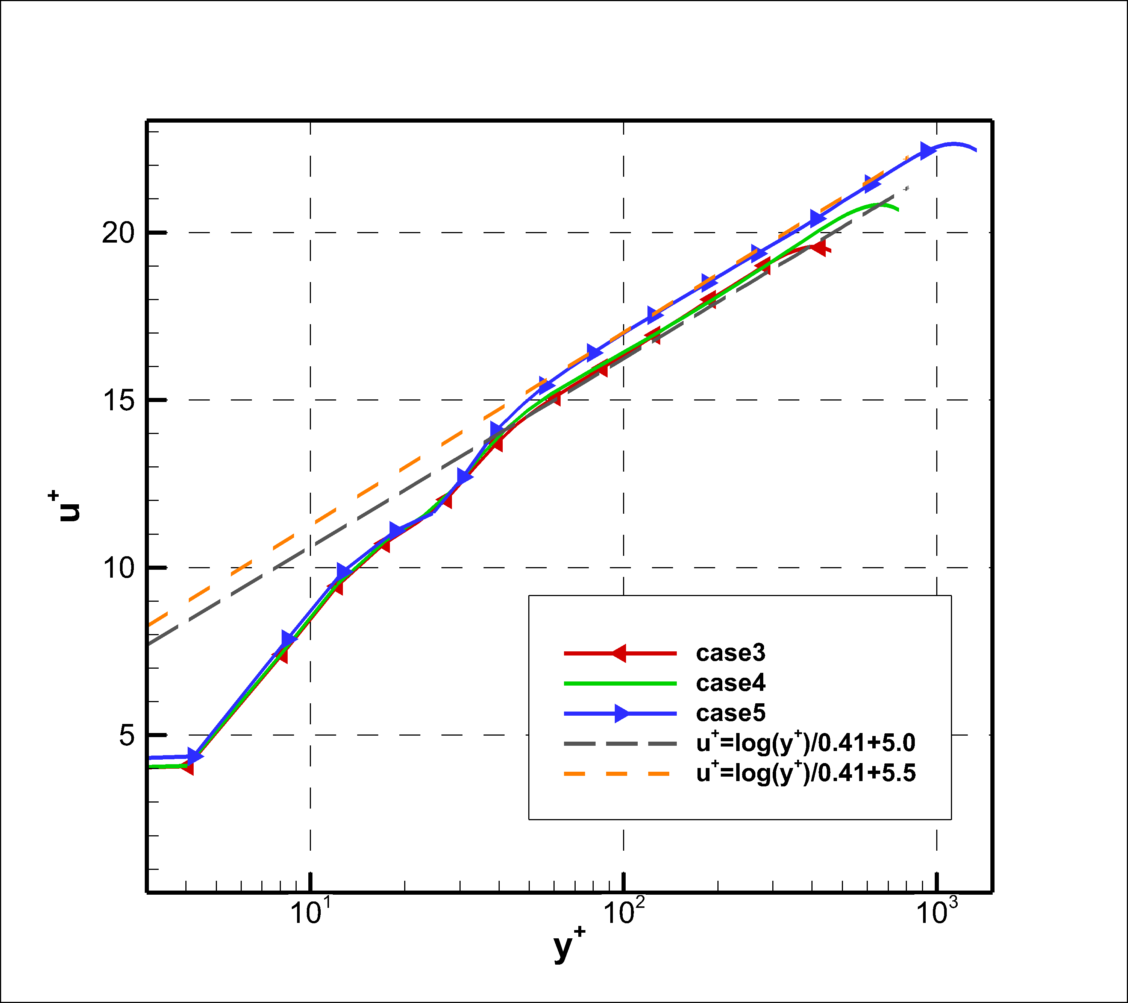
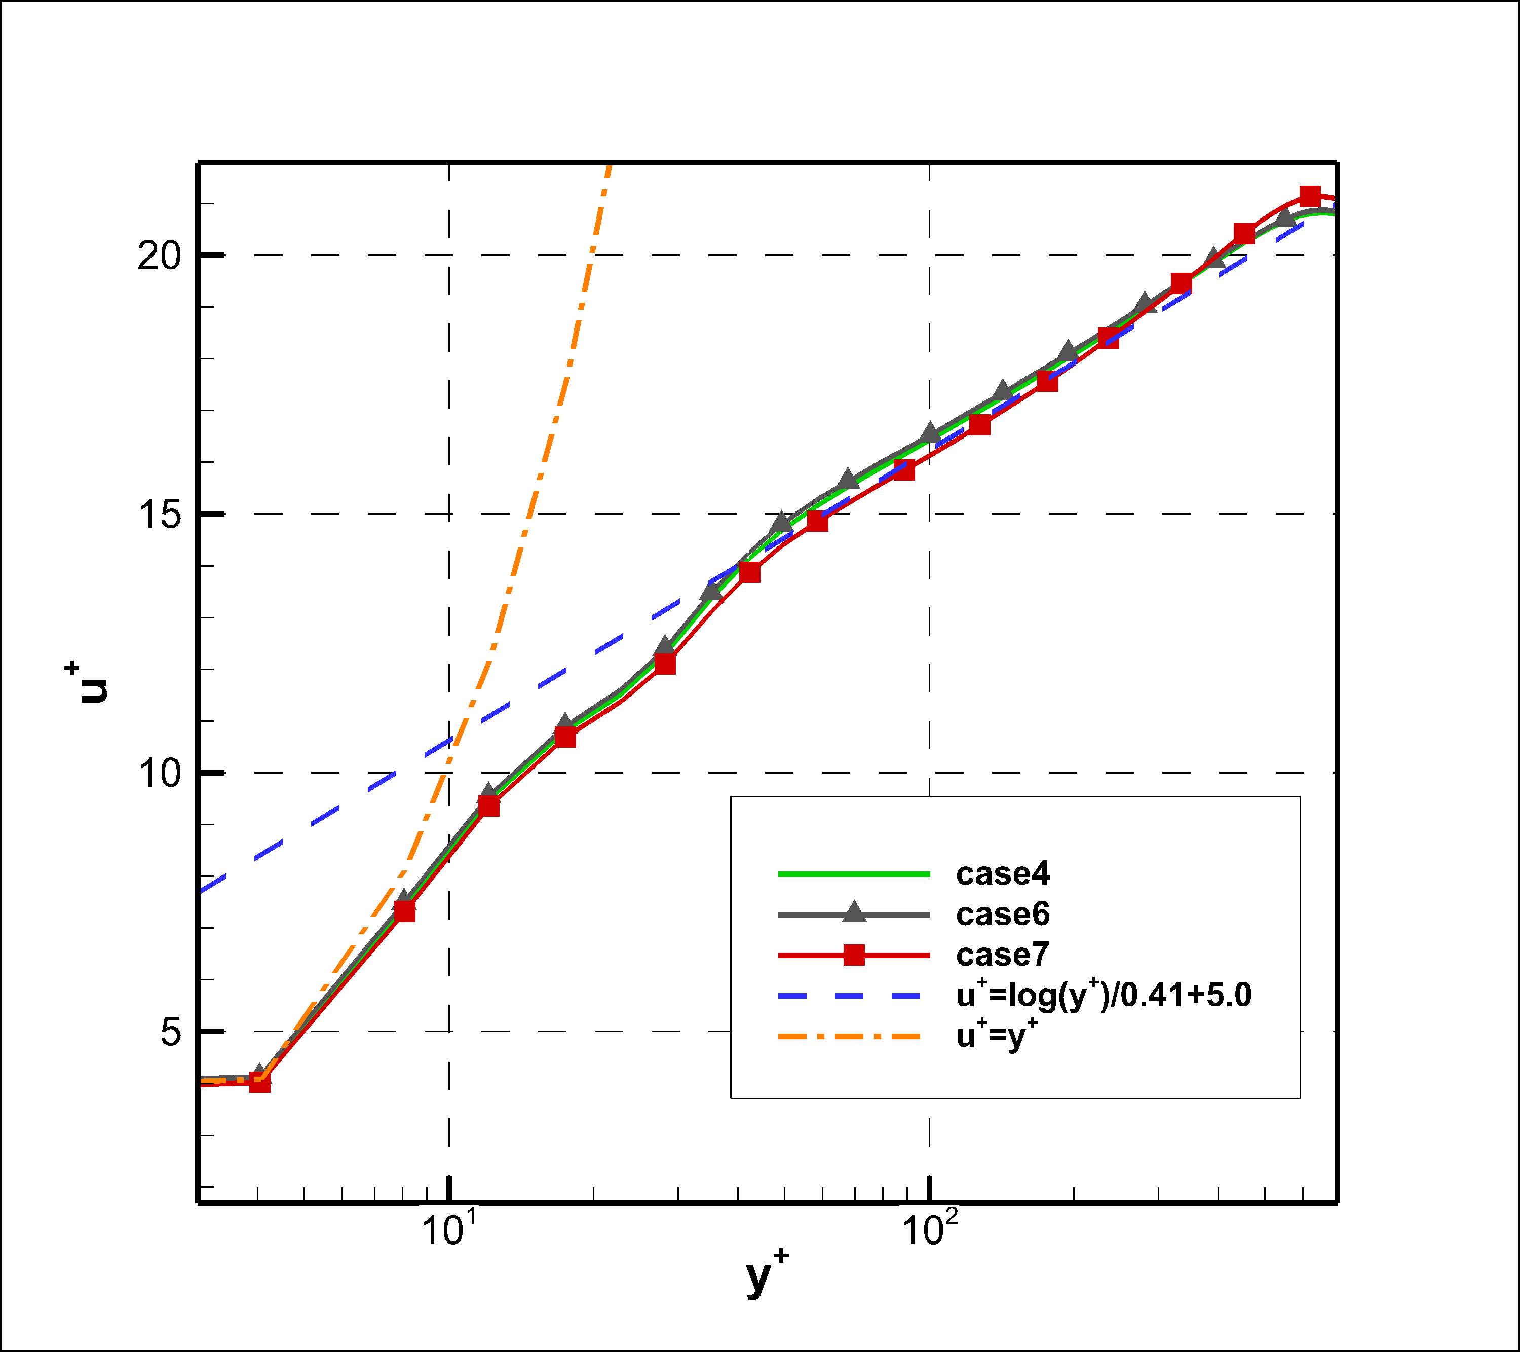
槽道湍流(3)
不同雷诺数：case 3,4,5
Re_{τ}=395, 640, 1140，
均符合对数律分布
截距5.0到5.5
网格敏感性验证：case4,6,7，Re_{τ}=640
法向网格分布：y⁺=8~12
流向/展向加密
基本上网格无关

Slide 32
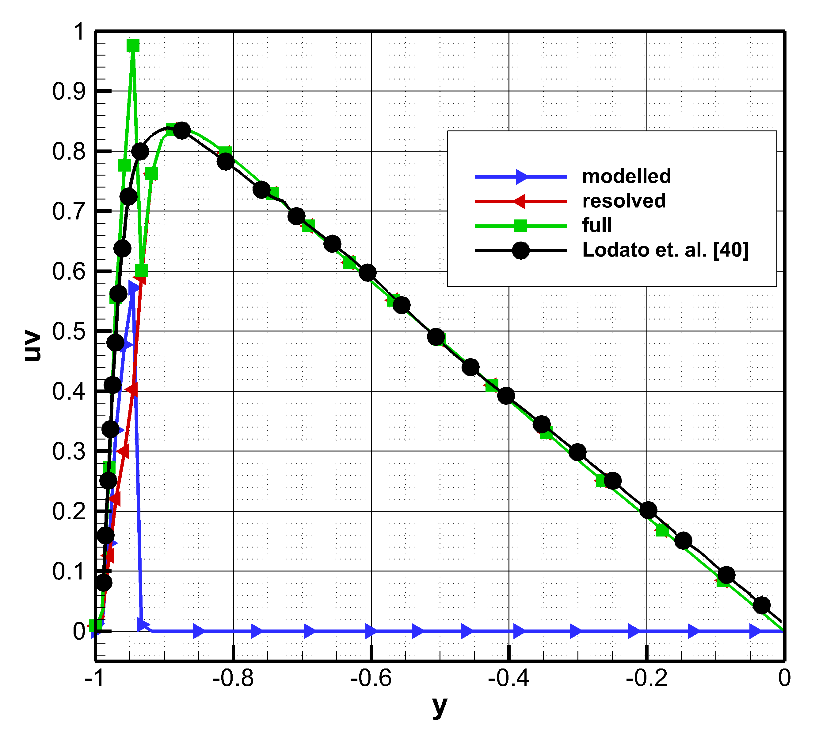
槽道湍流(4)
壁面模型的转换区
雷诺应力尖点对应于buffer layer速度拐折
对其他区域几乎没有影响

Slide 33
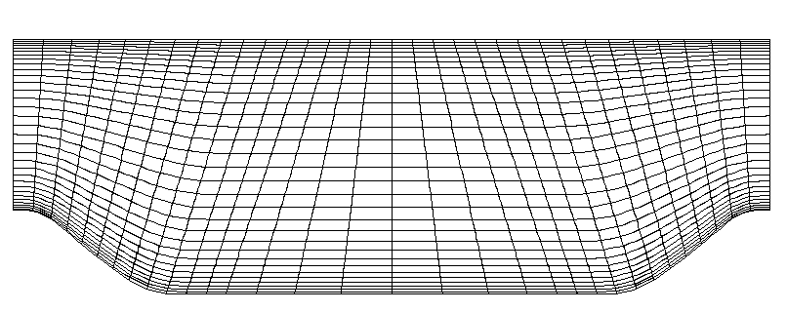
周期山算例(1)
顺压/逆压梯度
超出壁面模型设计范围
Re_{b} = 2800, 10595
低雷诺数：LES常见算例
高雷诺数：ATAAC算例
网格：
P3曲边网格
N_{x}×N_{y}×N_{z}
= 32×32×16
高雷诺数下对应ATAAC稀网格

Slide 34
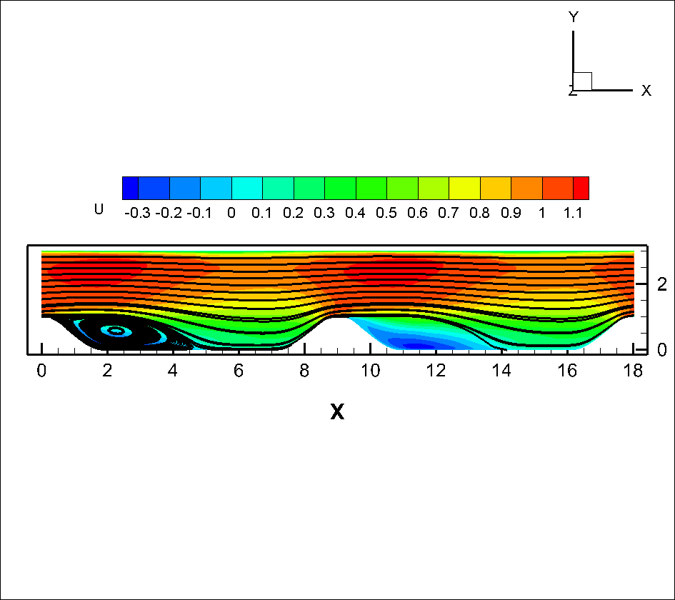
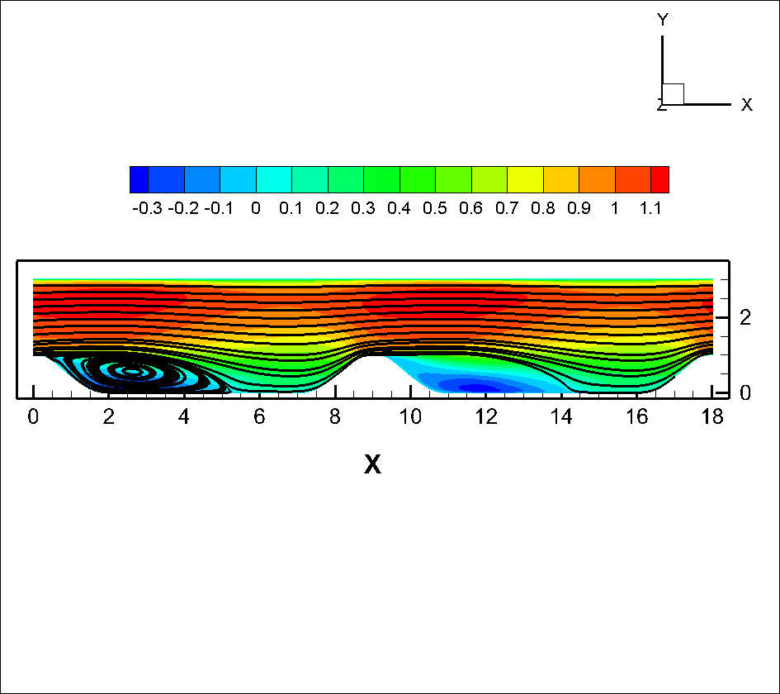
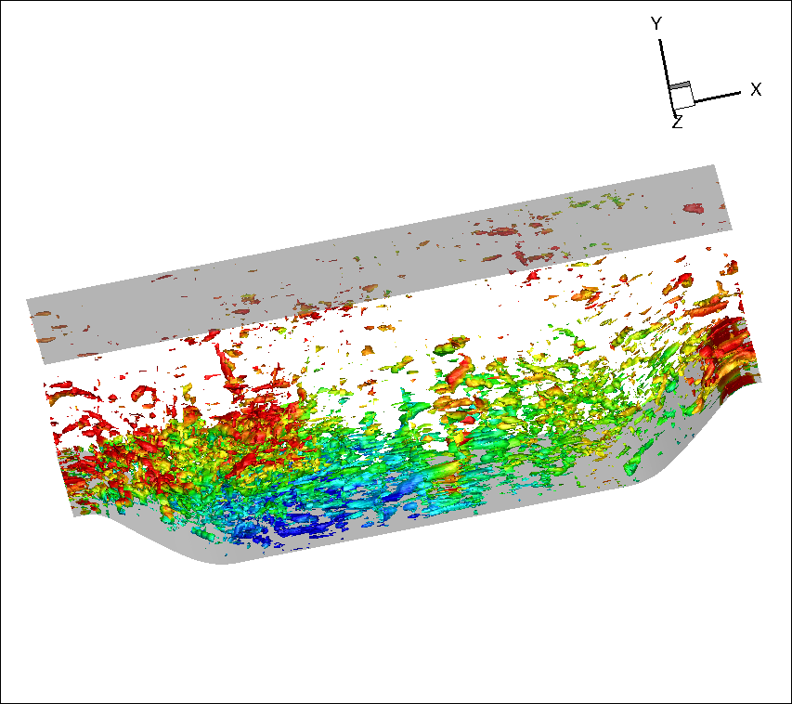
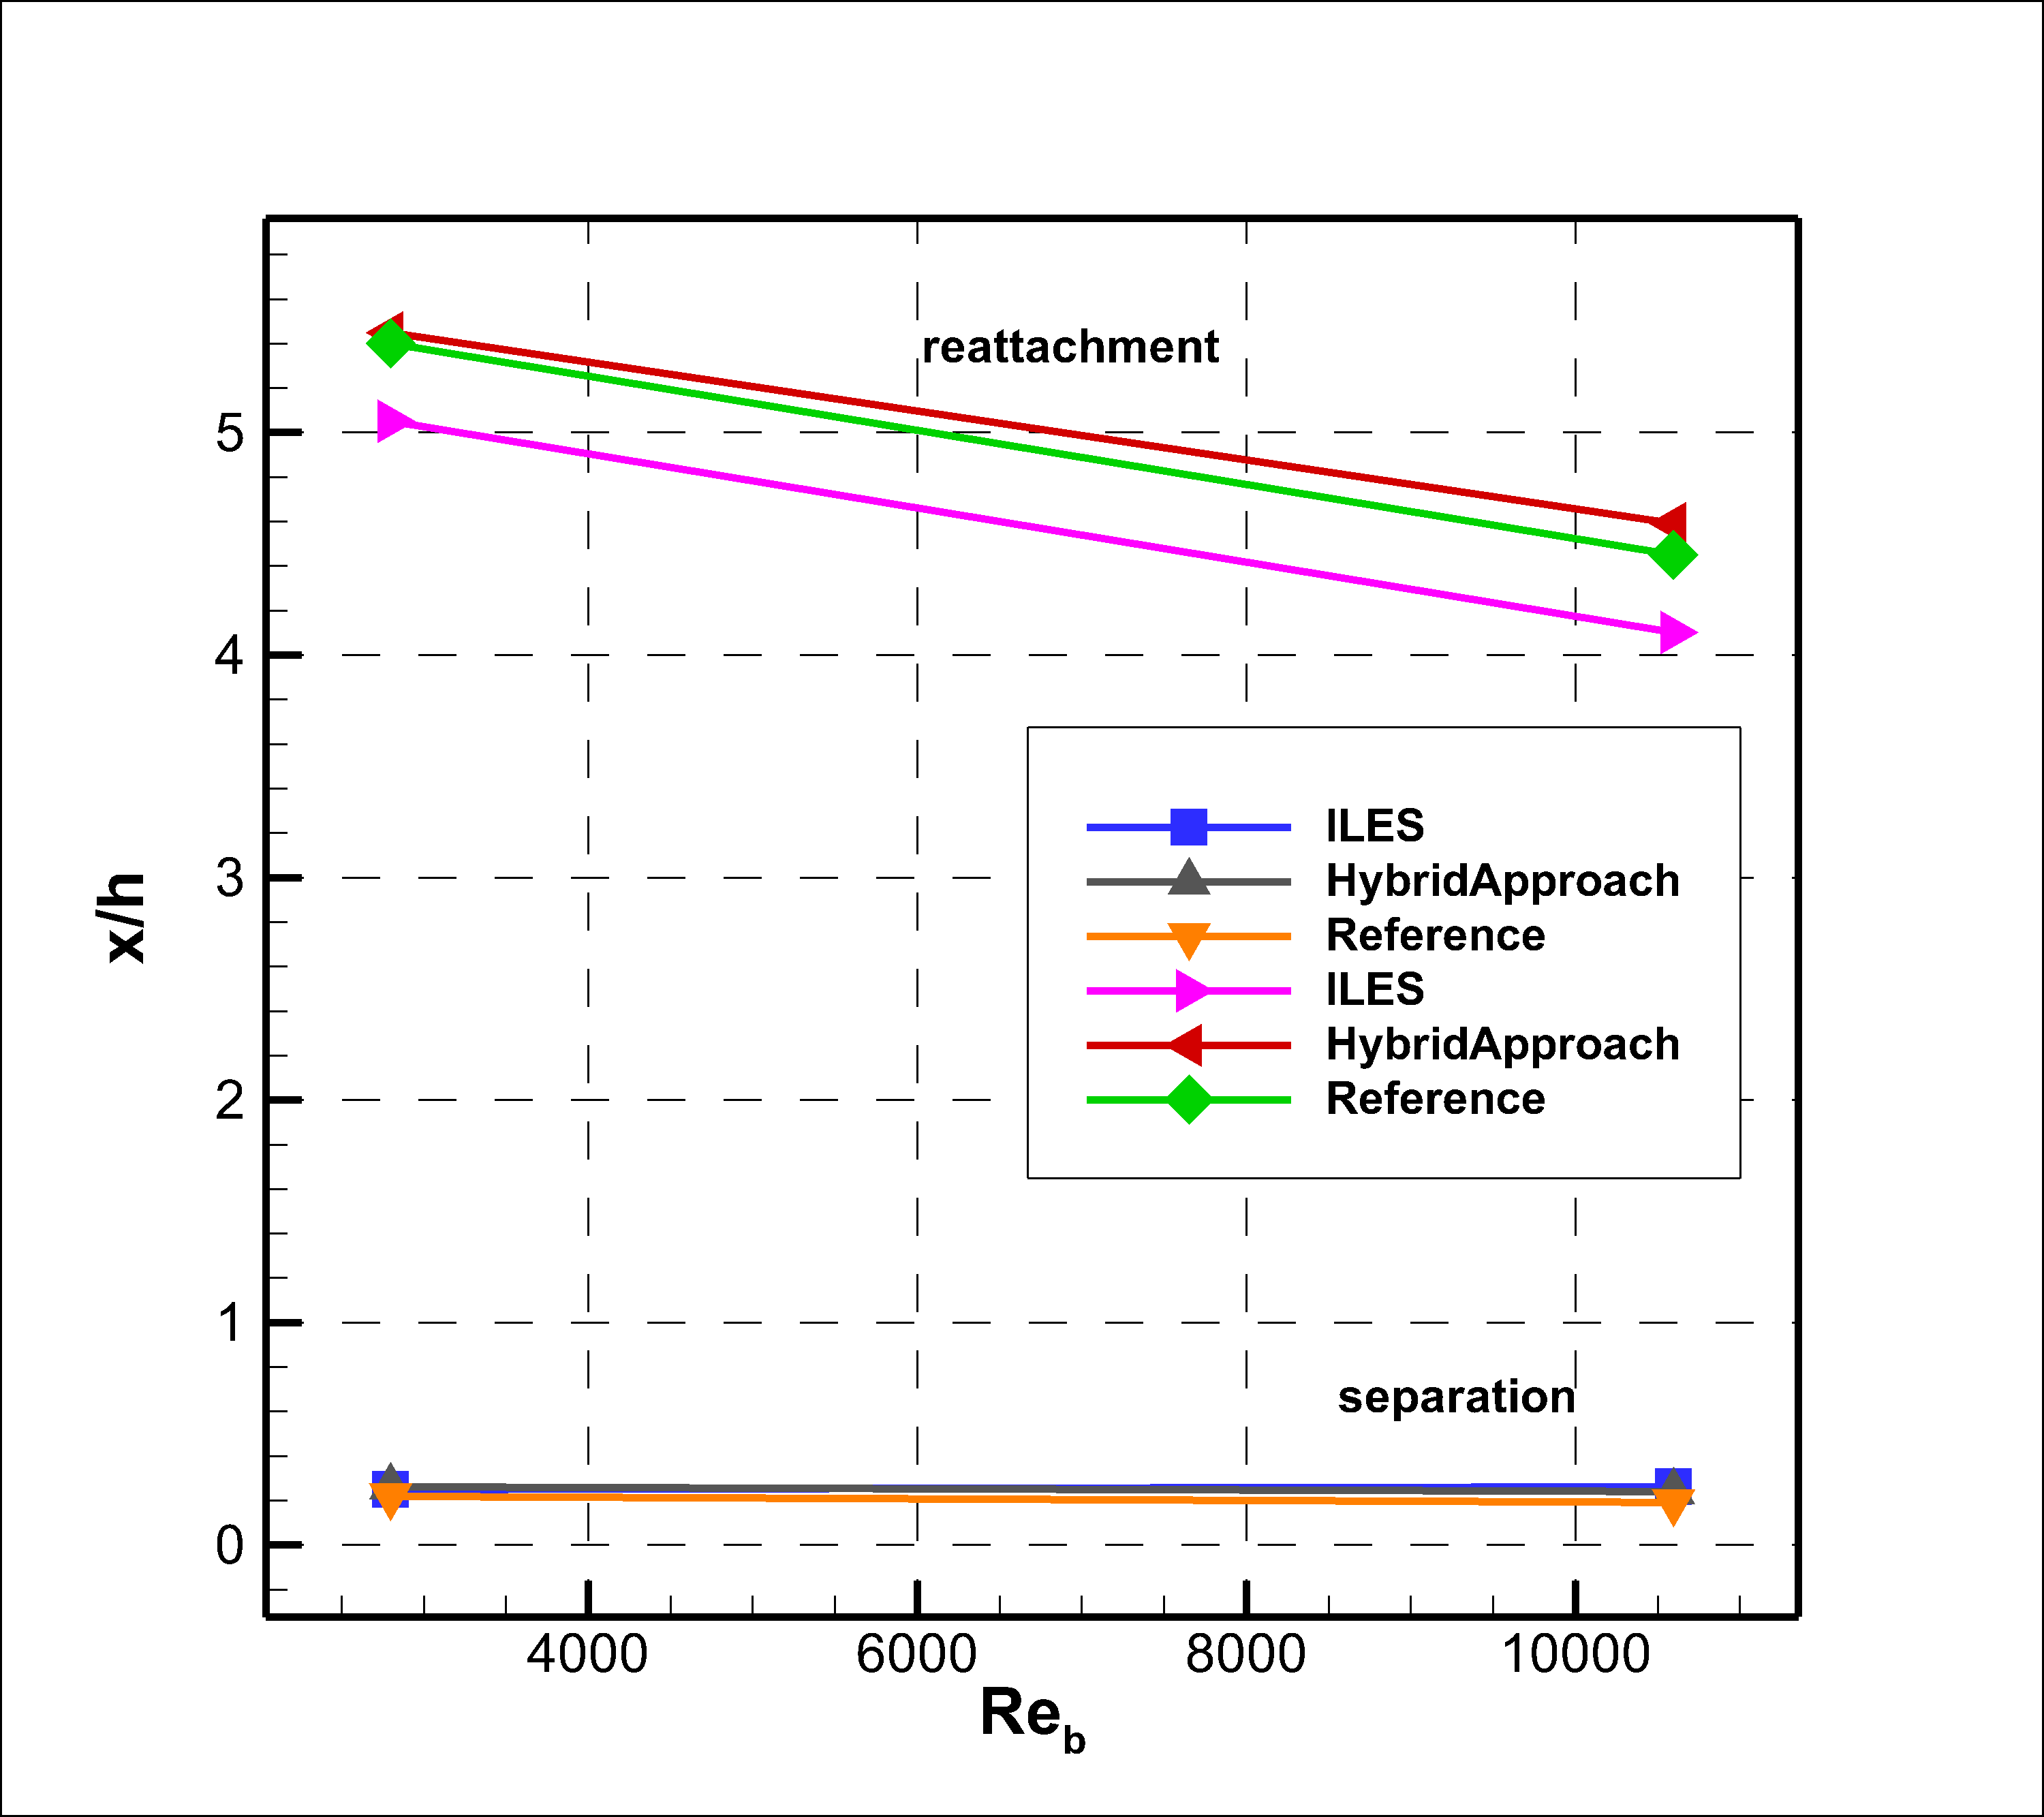
周期山算例(2)
无壁面模型
再附点提前
有壁面模型
再附点与参考值接近

Slide 35
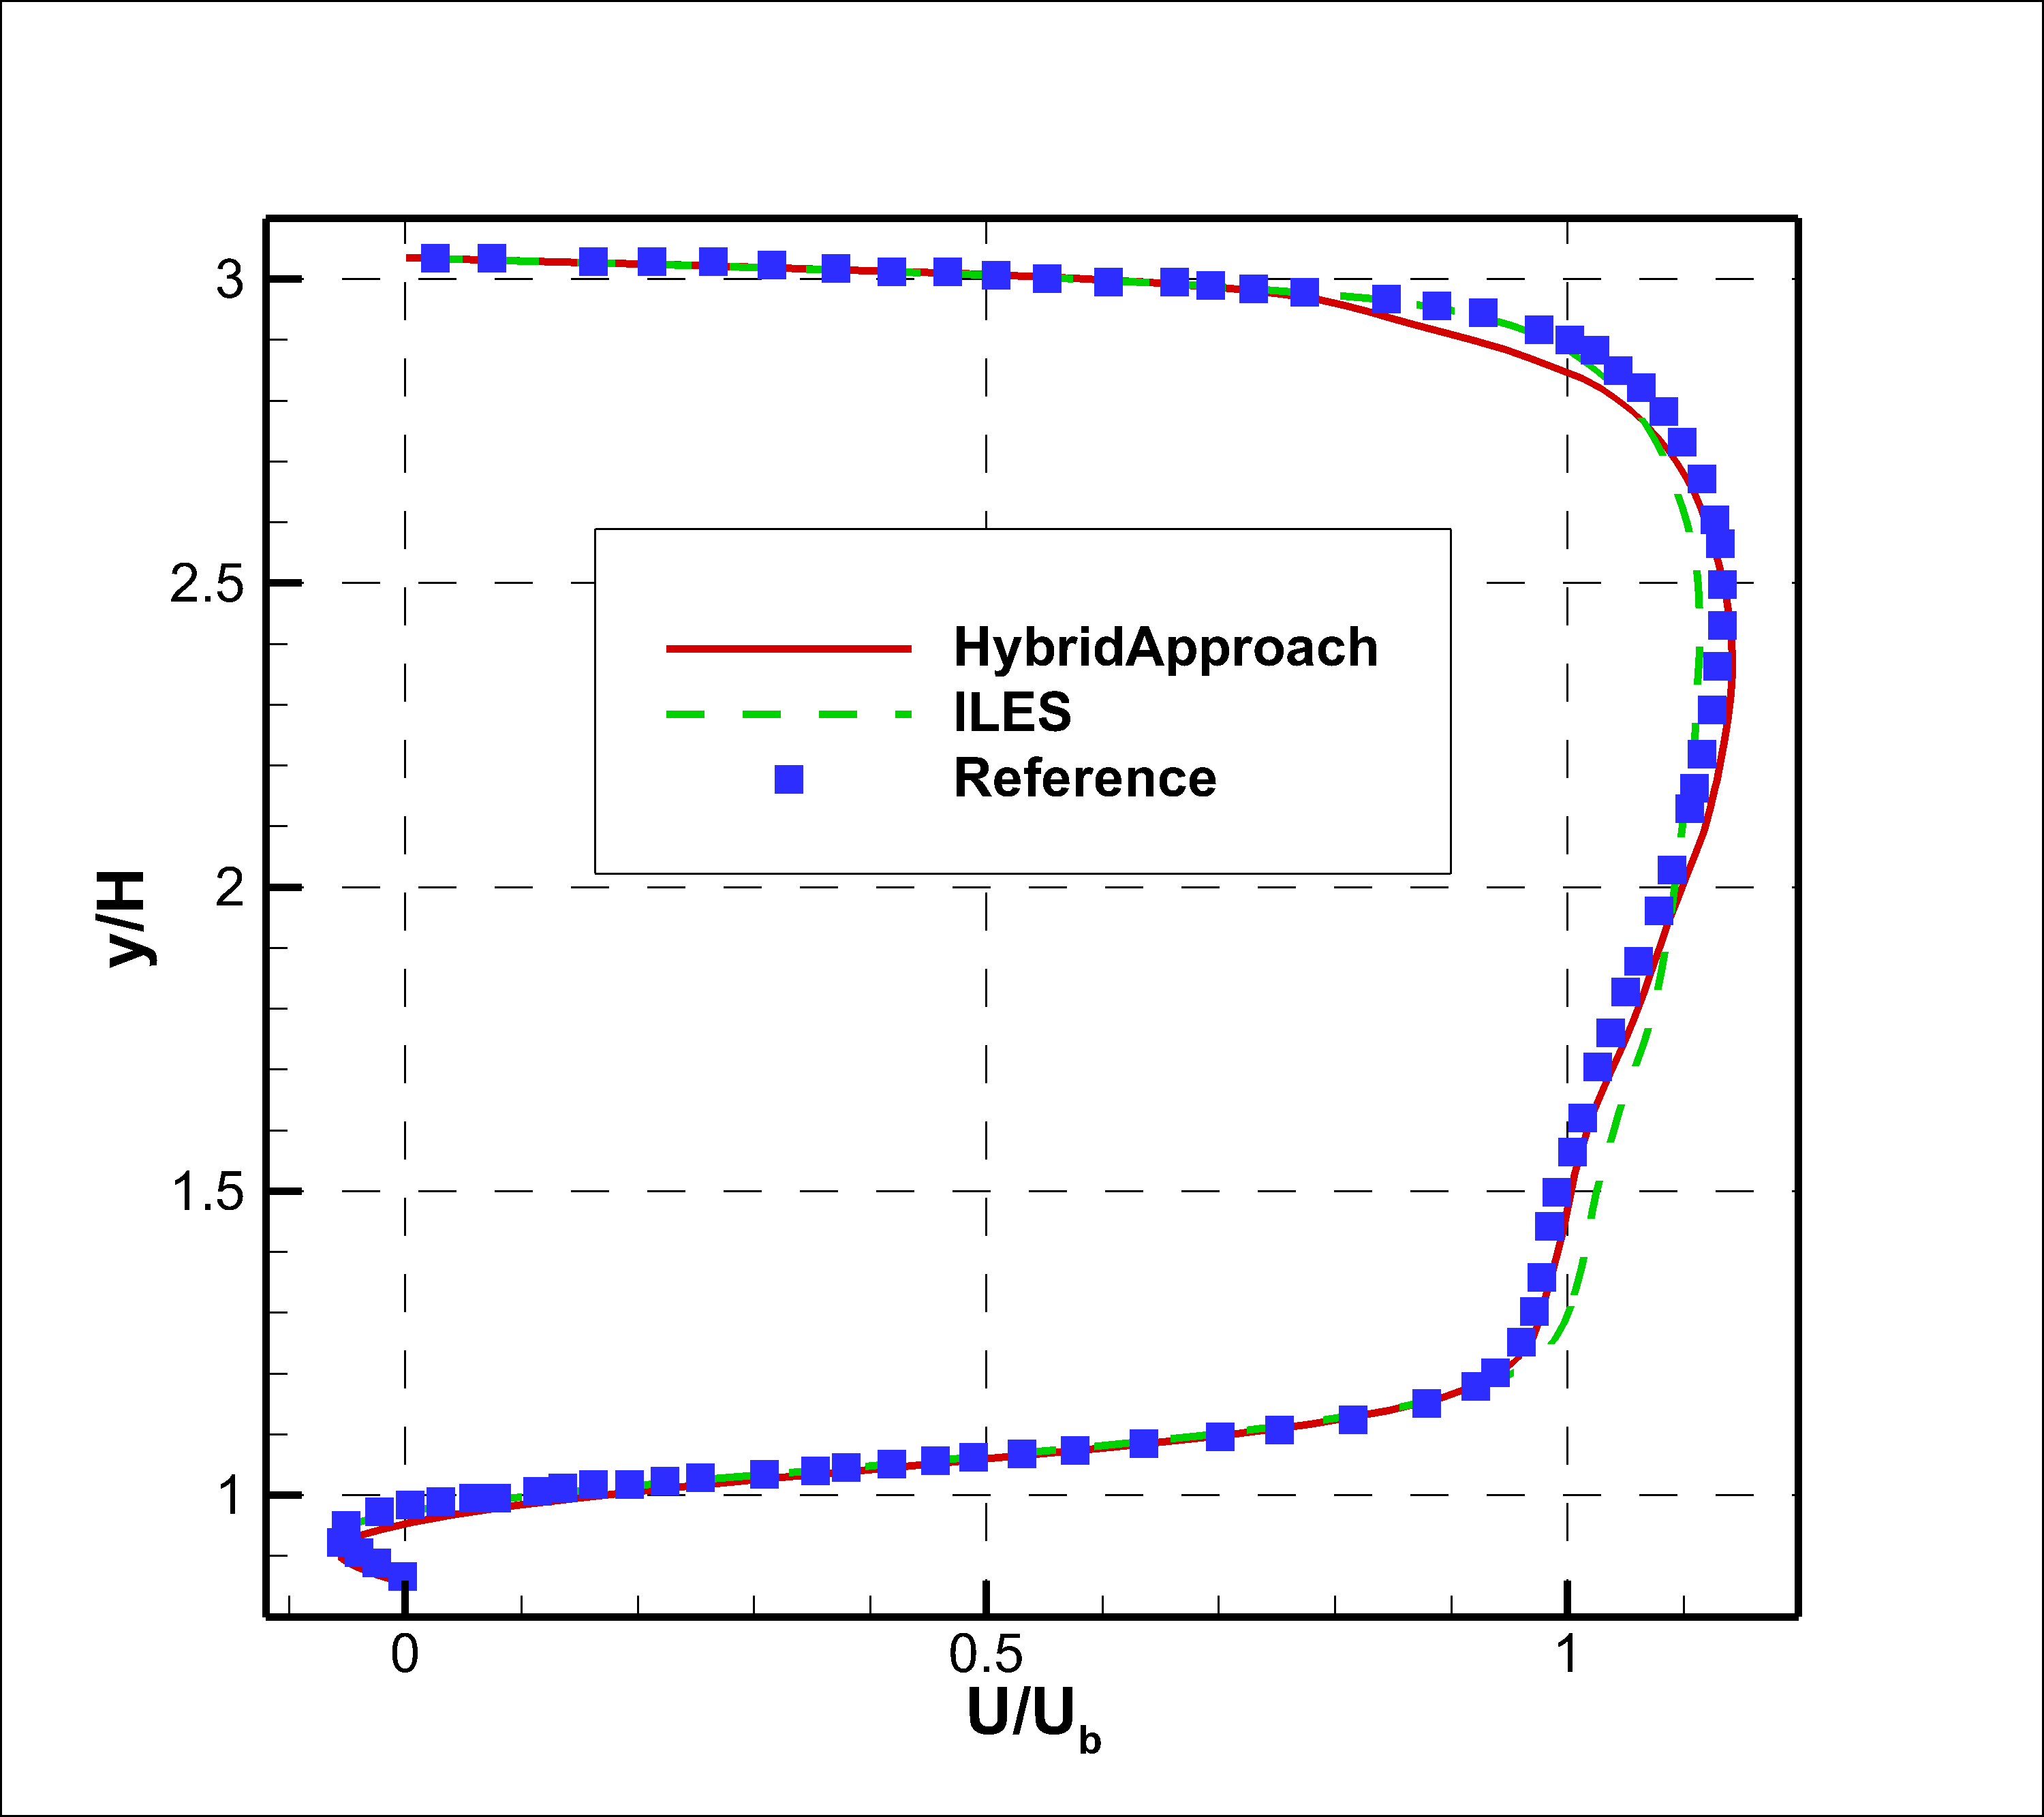
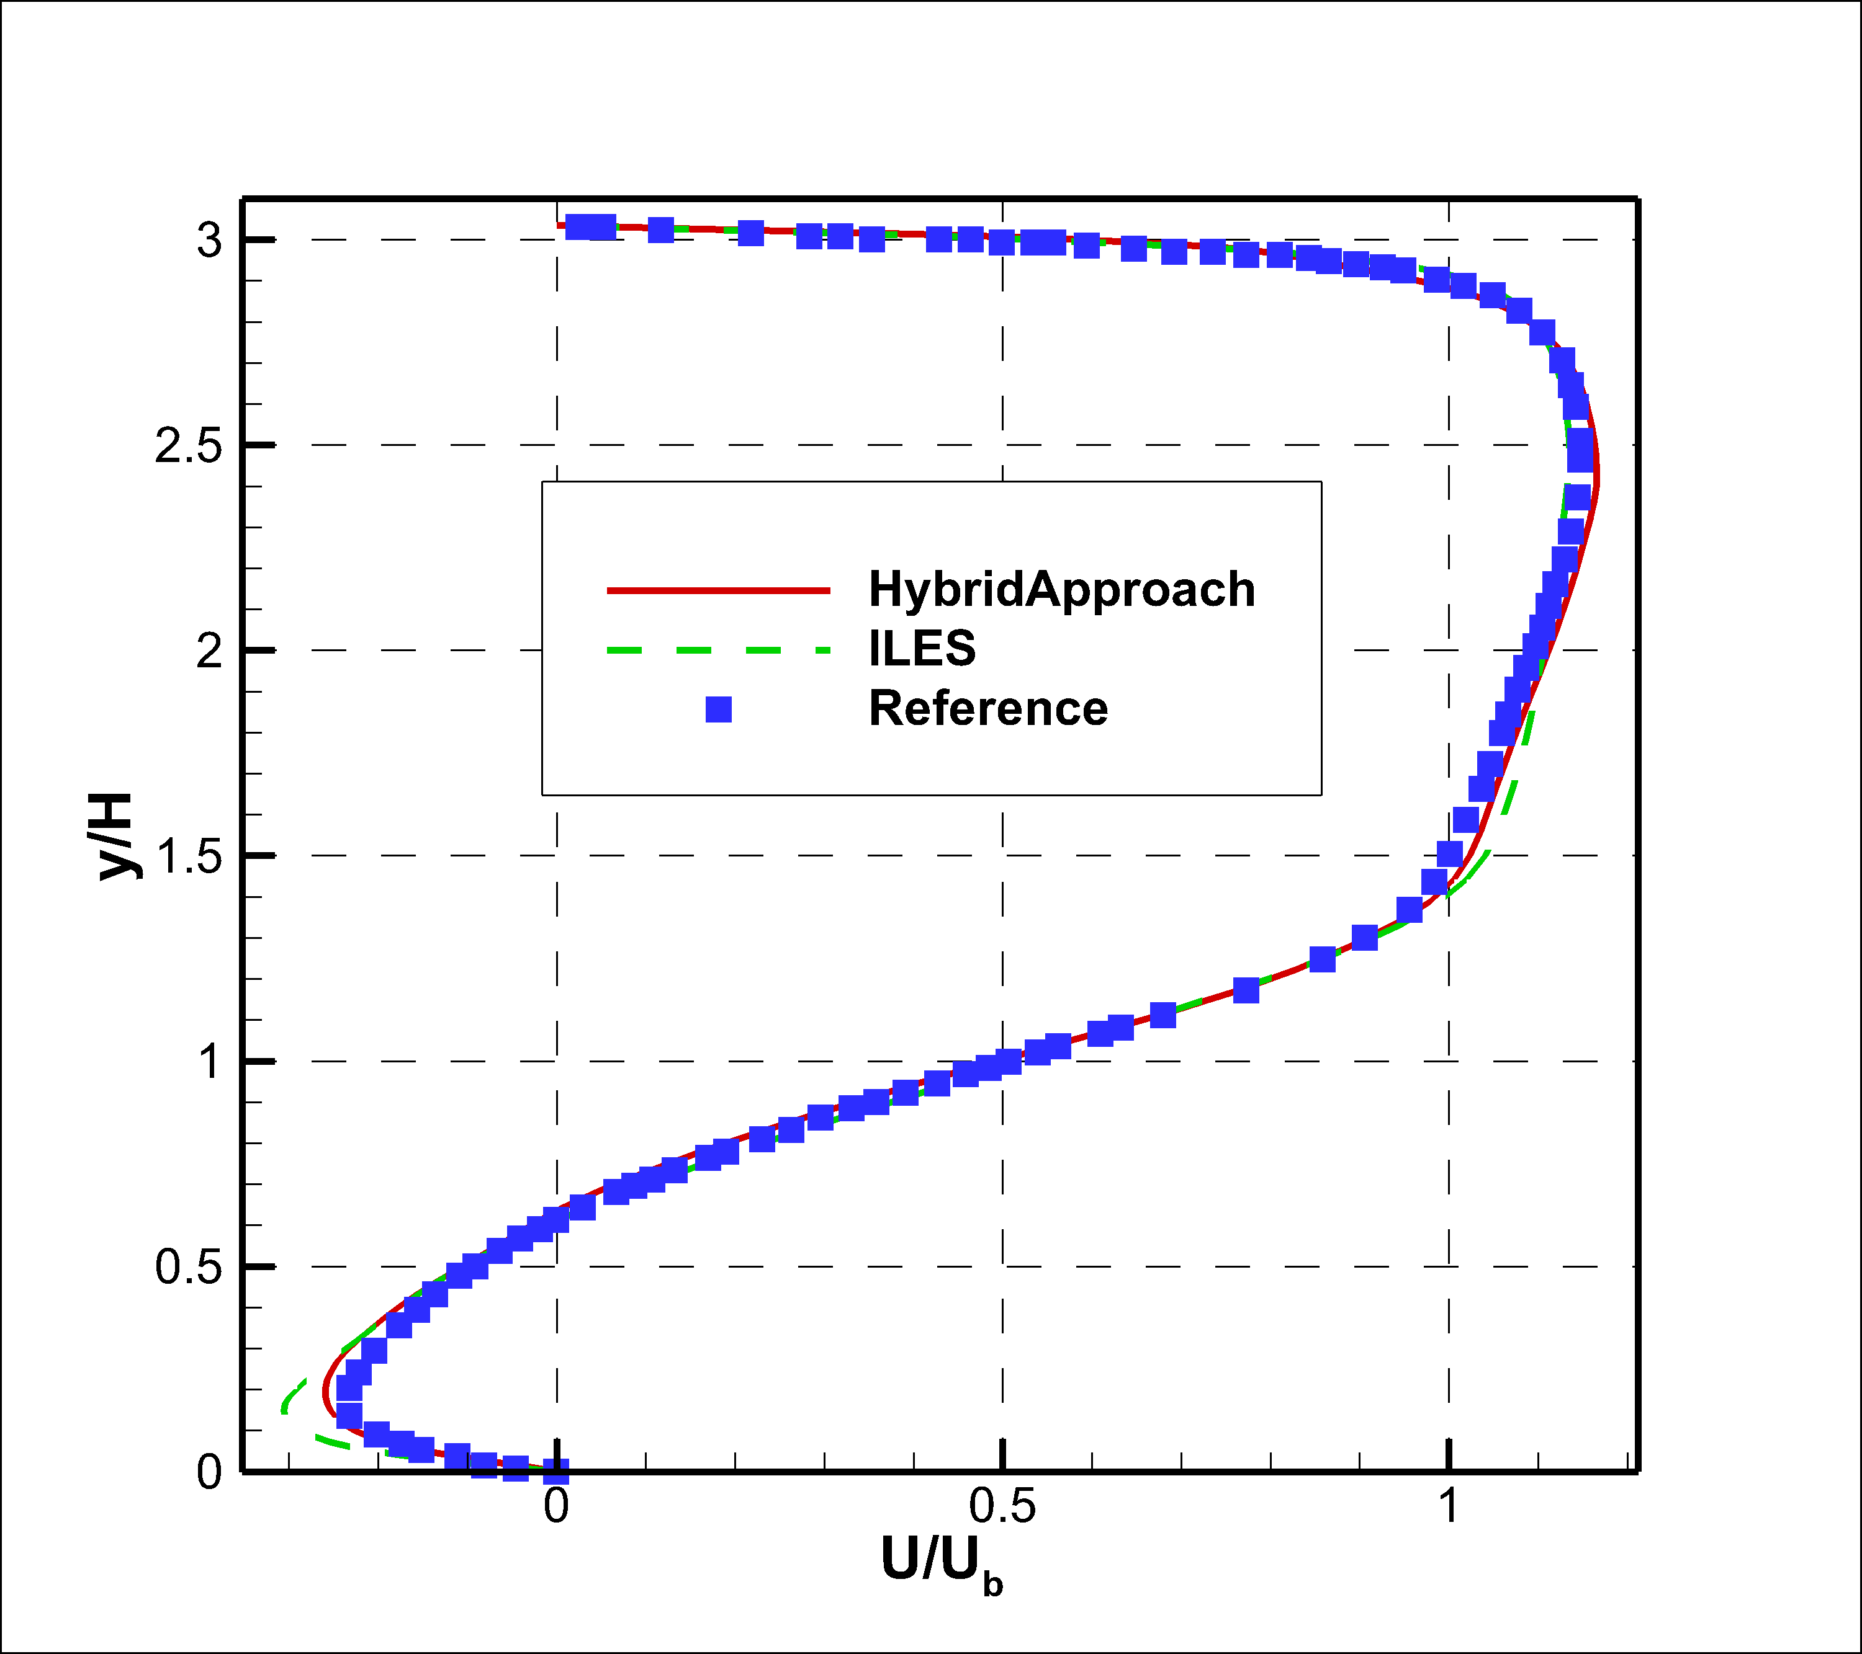
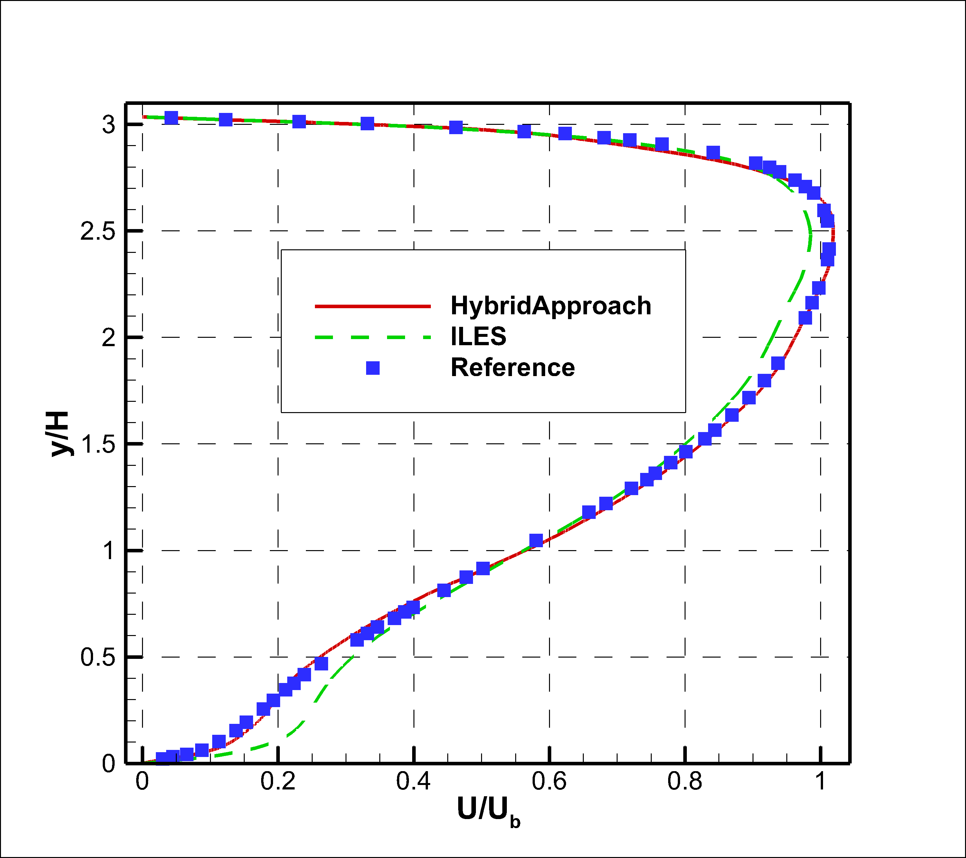
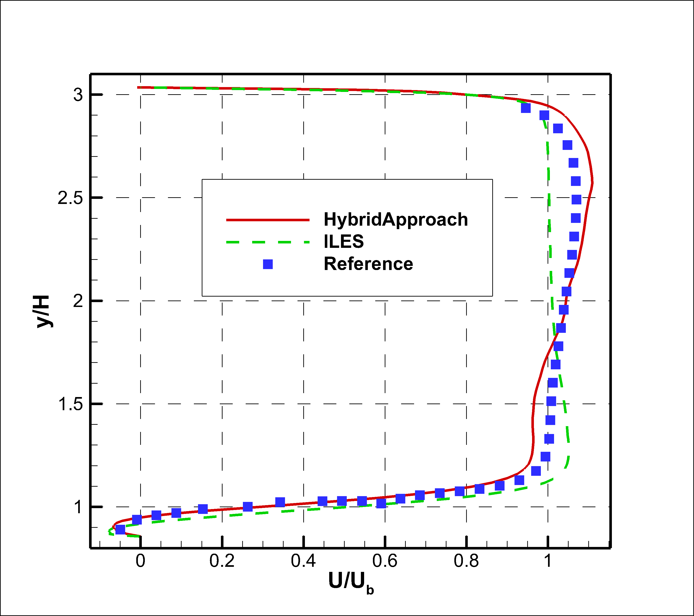
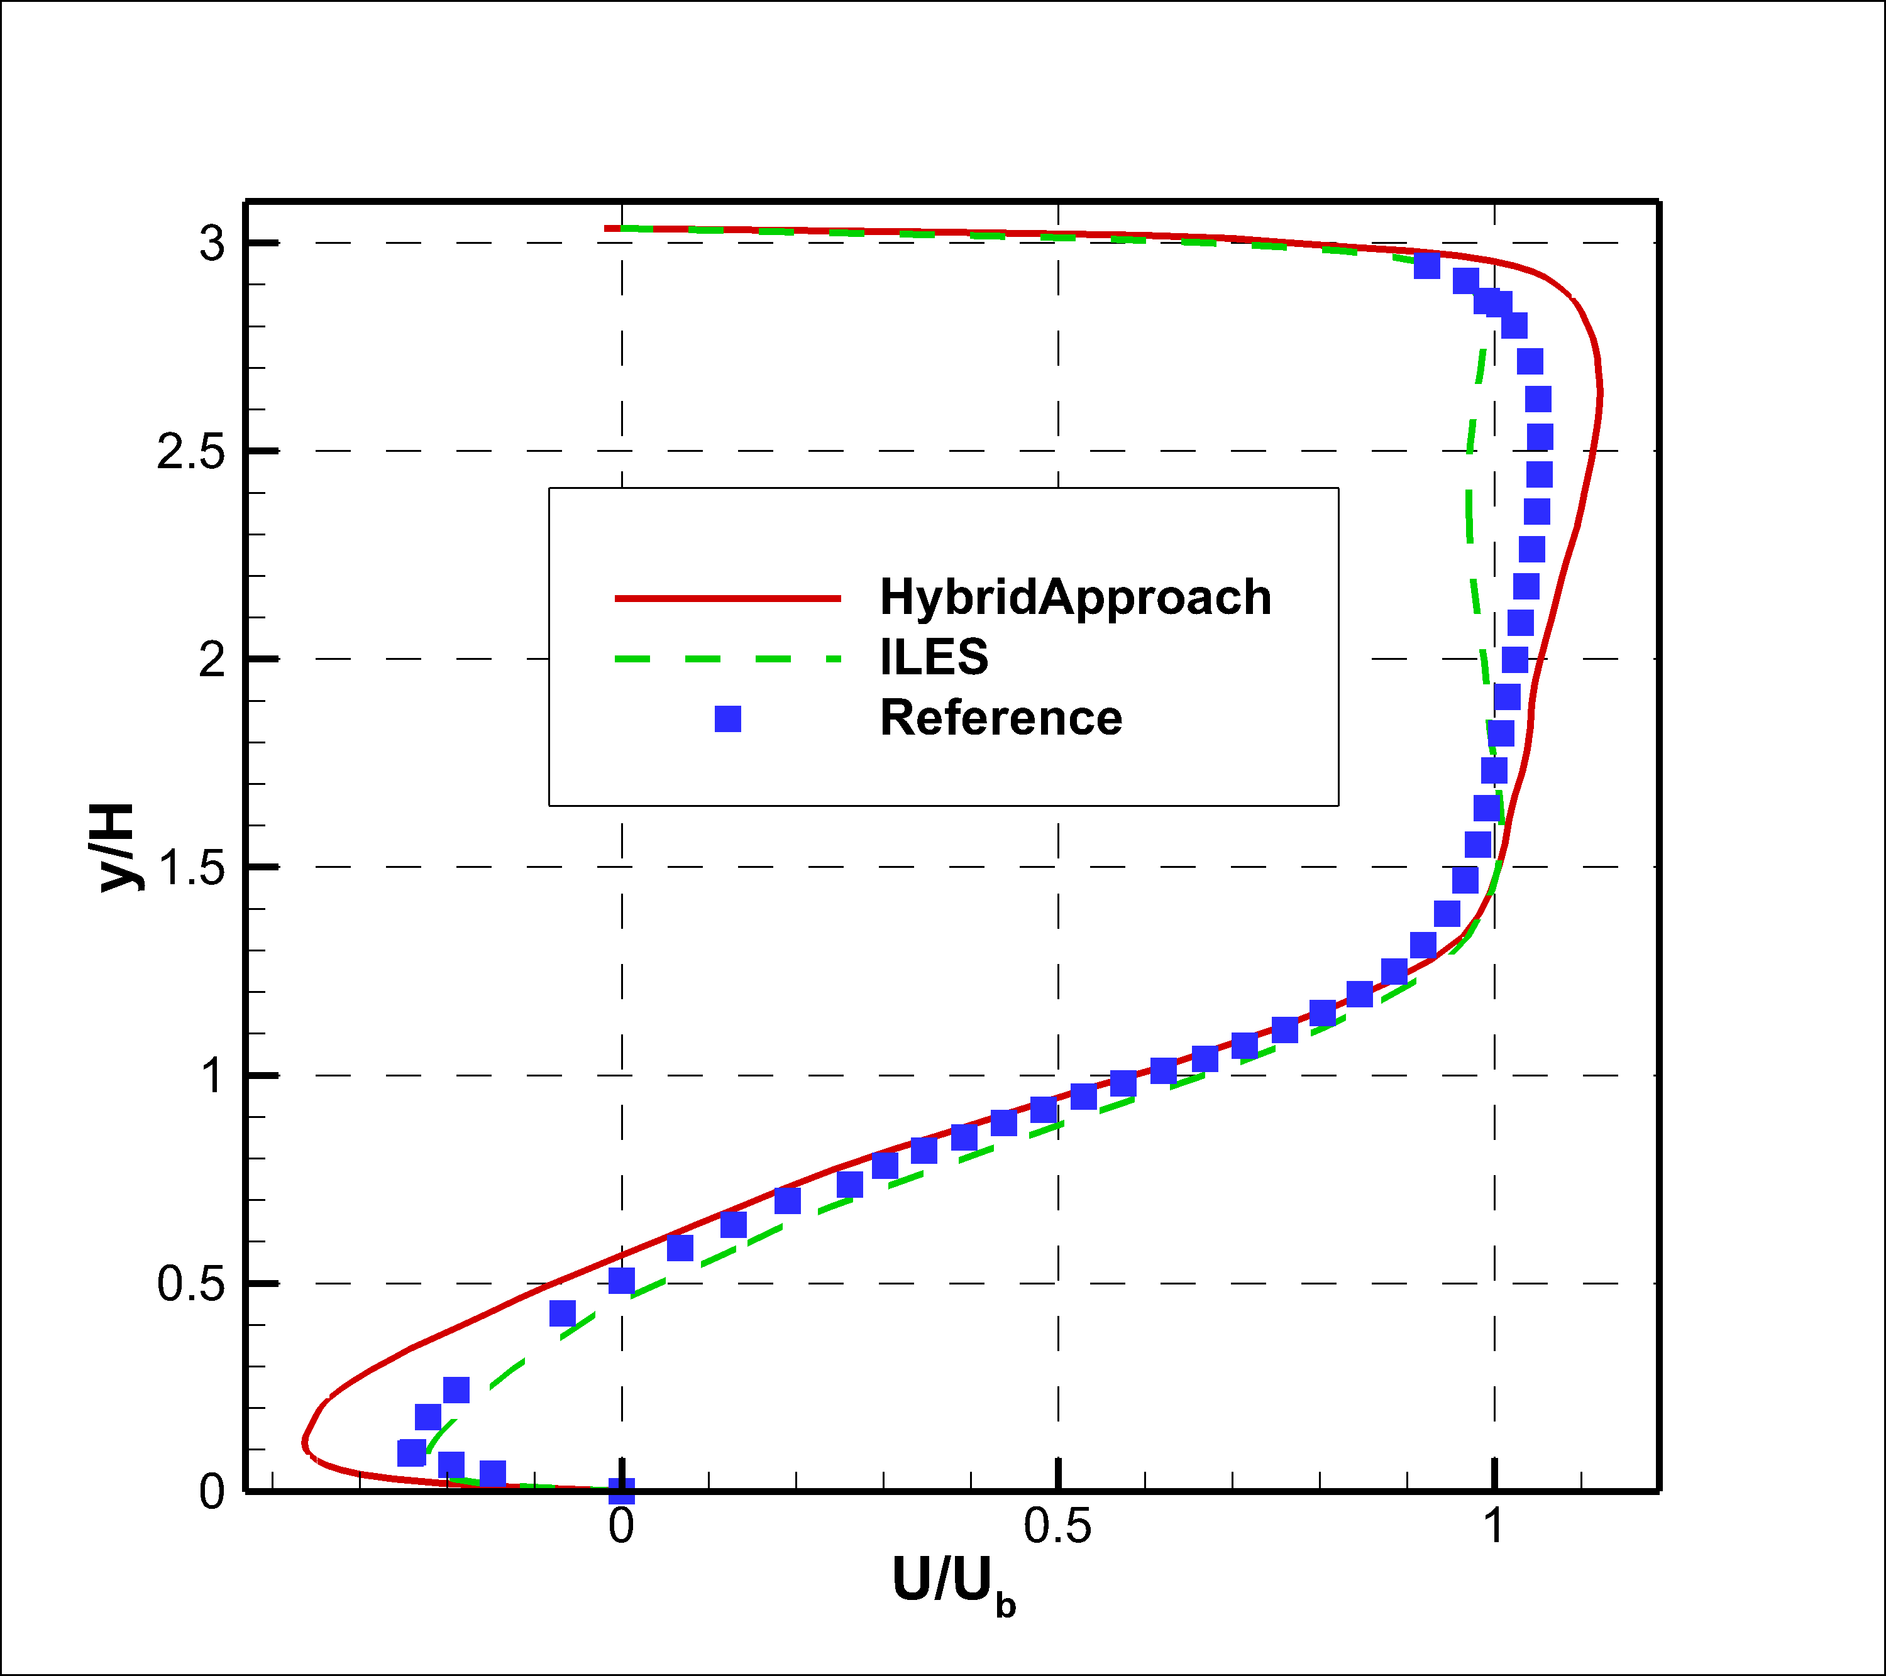
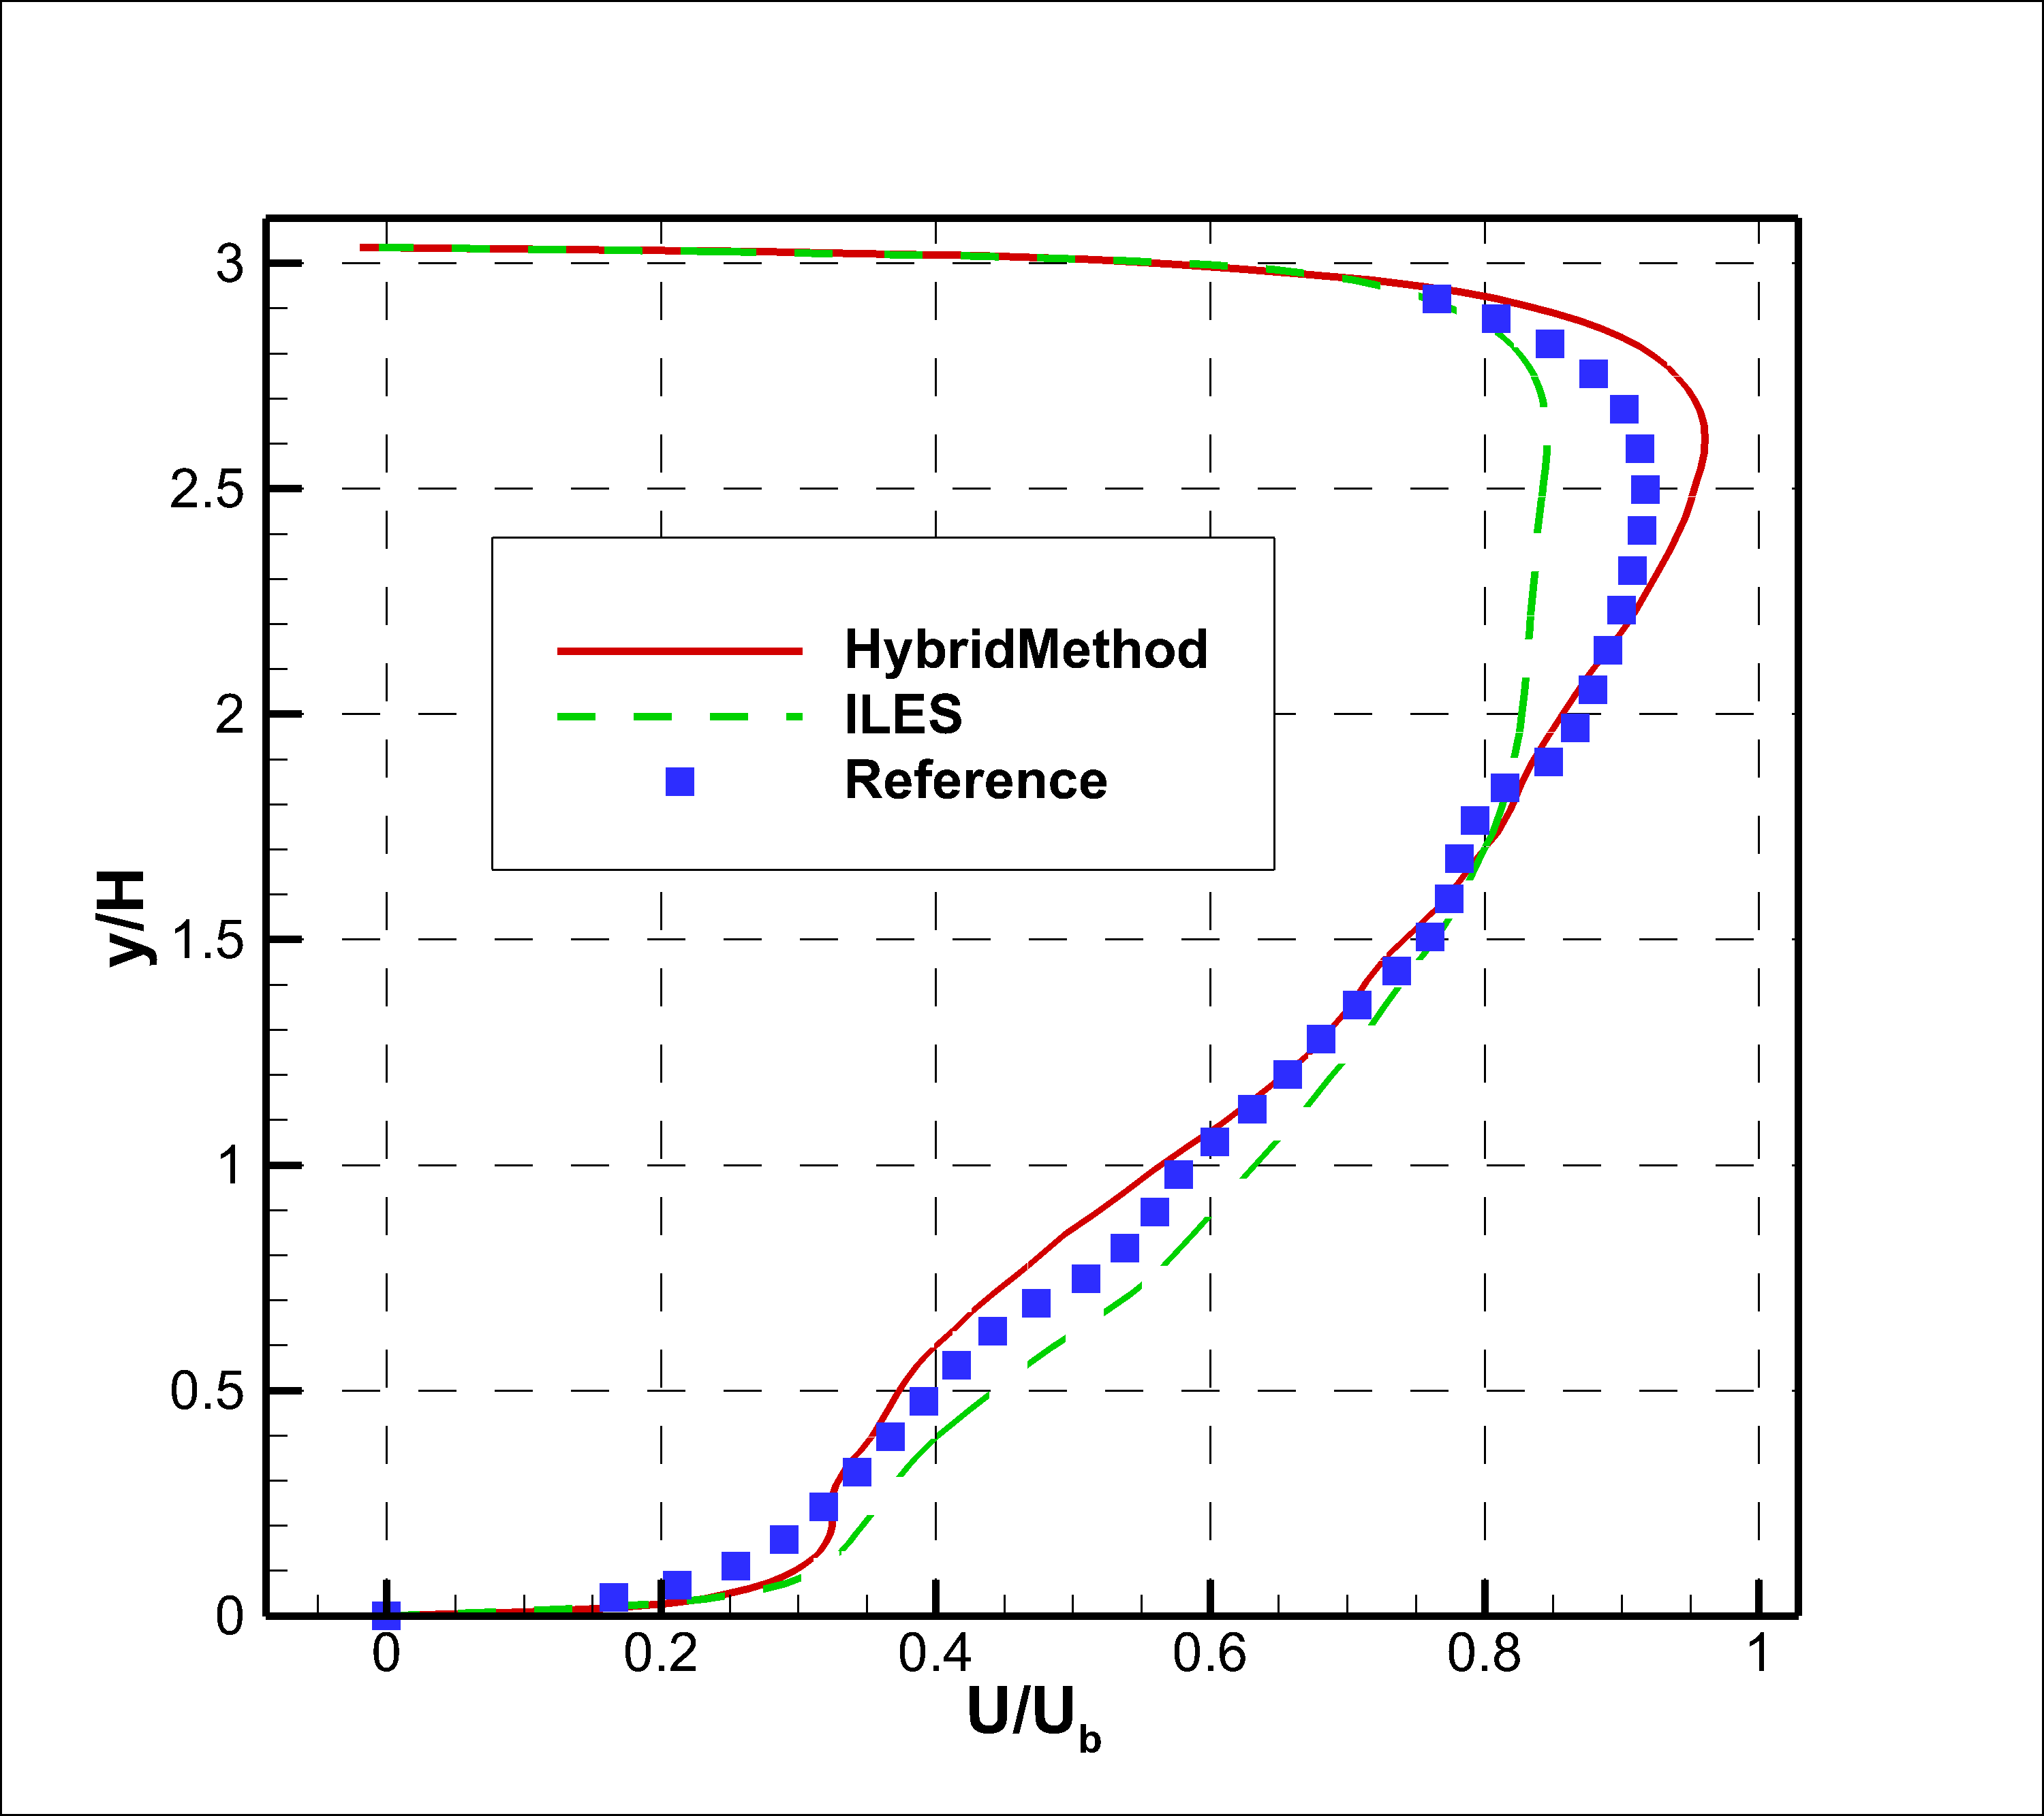
周期山算例(3)
速度型

Slide 36
本章小结
基于通量重构的隐式大涡模拟
亚网格等效粘性系数分析
亚临界圆柱绕流算例
新型壁面模型
近壁区：代数湍流模型
远离壁面：隐式大涡模拟
仅使用局部变量，适用于非结构网格

Slide 37
4.前台阶转捩流动研究

Slide 38
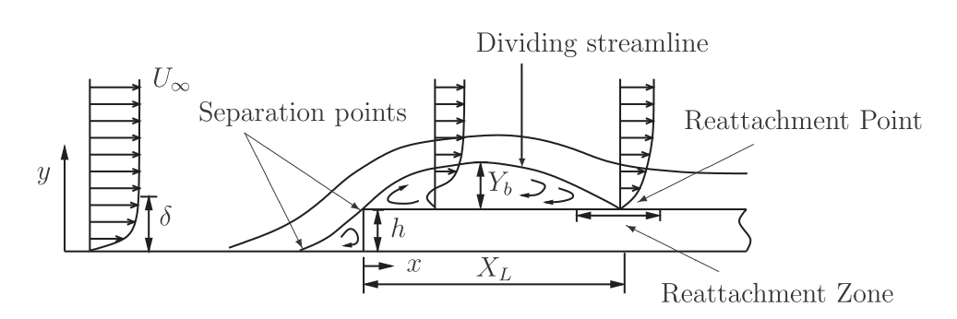
前台阶流动
二维几何扰动
是否会引起转捩？
流动物理比后台阶更复杂
两个分离区
基本参数
台阶高度与边界层高度之比 （小于1）
基于台阶高度的雷诺数 （处于转捩区间）
适用隐式大涡模拟
显式LES难以计算转捩SGS应力
DNS计算量难以承受

Slide 39
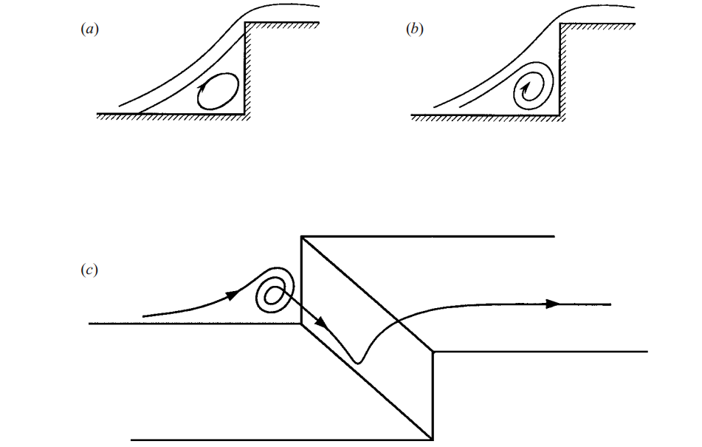
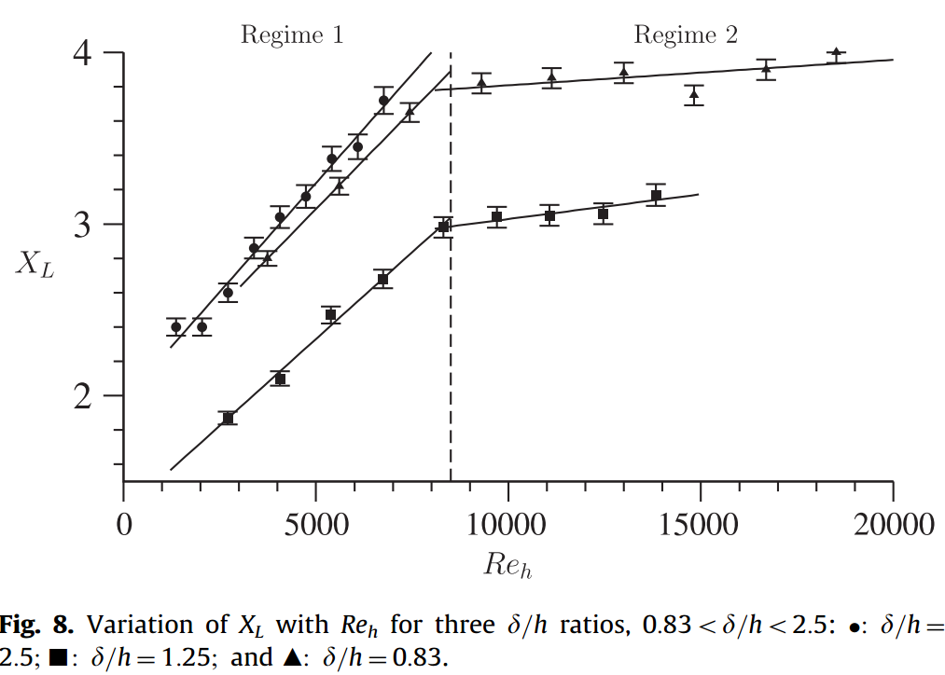
文献(1)
以雷诺数分类
很低，关注小扰动的发展
Wilhelm et. al. 2003 (JFM)：二维扰动如何变成三维扰动
很高，关注湍流边界层
Zukoski 1967 (AIAA J)：台阶前的第一分离区，超声速
Sherry et. al. 2010：台阶后的第二分离区

Slide 40
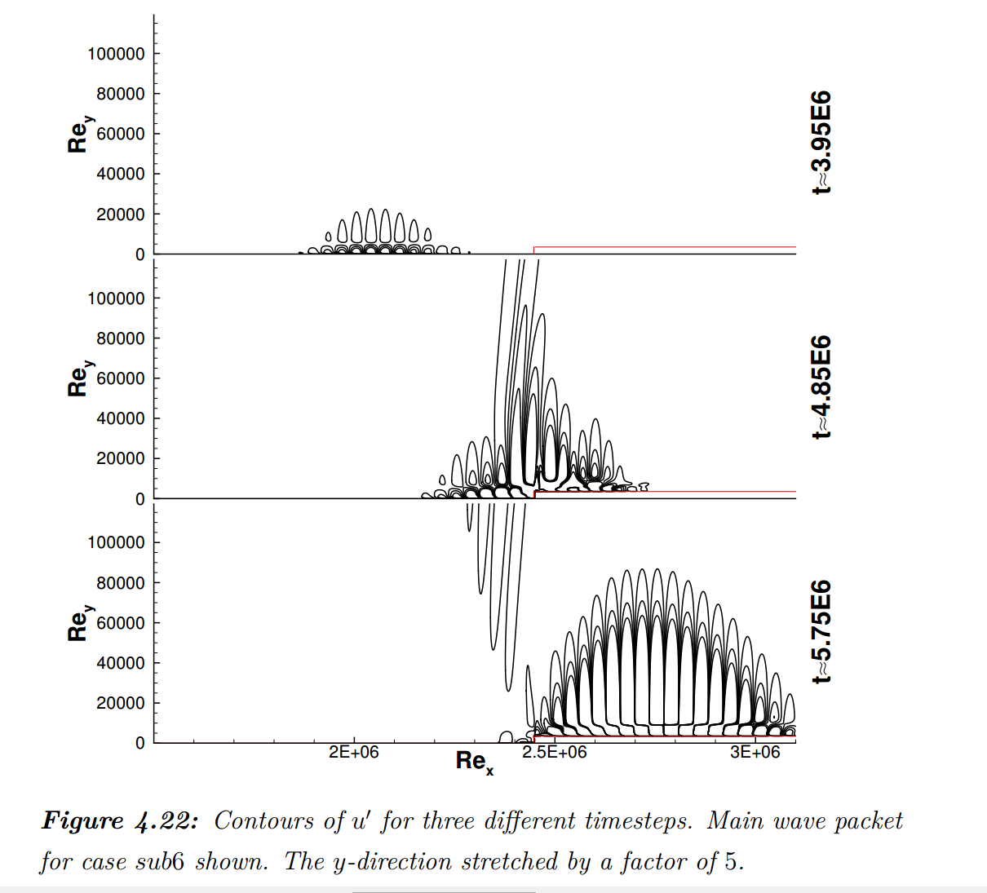
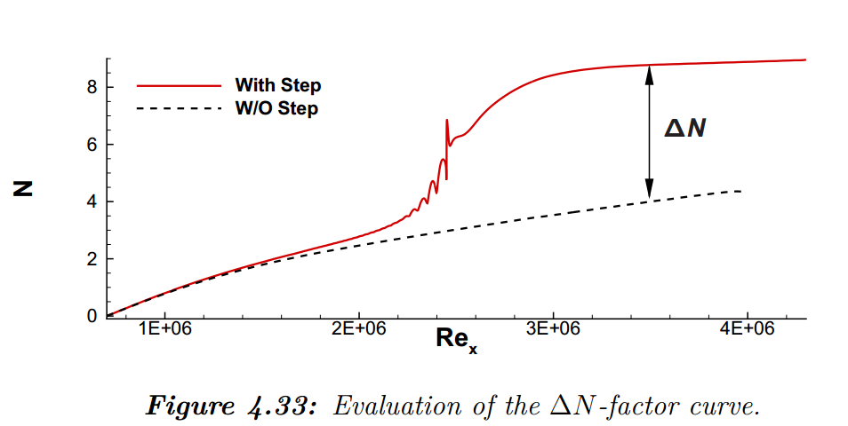
文献(2)
转捩雷诺数
Edelmann 2014 (DLR)
台阶上游壁面吹吸与波包演化
Re_{h} = 400~4440
扰动方程DNS
线性稳定性分析
Edelmann C A. Influence of forward-facing steps on laminar-turbulent transition

Slide 41
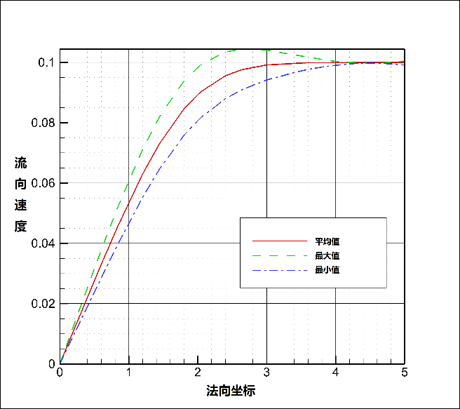

问题与算例
台阶与入口扰动如何相互作用？（中等雷诺数）
Re_{h}=720, Re_{xin}=186624, Re_{xstep}=330624
层流入口 + 有限扰动
低频三维扰动，类似T-S波
四阶通量重构
DOF ≈ 1500万
展向宽度30h
展向32单元
统计50万时间步

Slide 42



平均流动(1)
速度型
与平板对比
同样的入口扰动下，平板不转捩

Slide 43




平均流动(2)
湍动能
雷诺切应力
分离区

Slide 44



瞬时流动（1）
瞬时流向速度截面
平板 vs 台阶

Slide 45



瞬时流动（2）
小尺度流向涡
准定常
Taylor-Gortler失稳

Slide 46


瞬时流动（3）
分离区
失稳、流向涡
K型转捩

Slide 47







频谱分析（1）
台阶上游
St = 0.01主频
台阶面
展向差别不大

Slide 48






频谱分析（2）
台阶下游
依然以低频为主
压力脉动幅度升高了一个量级

Slide 49
本章小结
采用高精度通量重构方法对前台阶诱导转捩流动进行了隐式大涡模拟
平板流动
验证了入口扰动本身不能引起流动转捩
前台阶平均流动结果
台阶前会产生流动分离，分离区外的流线会发生弯曲
前台阶瞬时流动结果
Taylor-Gortler不稳定性，流向涡
越过台阶面后，会在台阶下游边界层里诱导产生展向结构
进一步发展形成发卡涡，K型转捩

Slide 50
5.总结与展望

Slide 51
总结
基于通量重构方法的隐式大涡模拟
分析其数值性质
圆柱绕流算例
适用于隐式大涡模拟的新型壁面模型
代数形式
仅使用当地变量
前台阶诱导转捩流动
转捩机理

Slide 52
研究展望
基于高精度通量重构方法的隐式大涡模拟
在高波数下会产生等效涡粘系数下降的现象
可能与网格尺度过大时的计算不稳定性相关
可能通过对通量重构方法进行修改从而获得更好的等效涡粘系数分布
新型壁面模型
在转换区内仍存在速度拐折和雷诺应力偏差，通过调整过渡函数中的参数可能对这一现象得到改善
低速边界层中的前台阶诱导转捩流动
不同雷诺数
不同台阶高度

Slide 53
谢谢！

Slide 54
已发表的学术成果
[1] Hui Zhu, Song Fu, Lei Shi, and Z. J. Wang, "Implicit Large-Eddy Simulation for the High-Order Flux Reconstruction Method", AIAA Journal, Vol. 54, No. 9, (2016), pp. 2721-2733.
[2] Hui Zhu, Song Fu, "Forward Facing Step Roughness Effect on Hypersonic Boundary Layer Flow", APCOM 2014
[3] 朱辉，肖志祥，符松，某先进战斗机大攻角气动性能及其控制研究，国防技术报告, 2012
[4] Hui Zhu, Song Fu, Lei Shi, and Z. J. Wang, " A Hybrid RANS-Implicit LES Approach for the High-Order FR/CPR Method ", 54th AIAA Aerospace Sciences Meeting, 2016

Slide 55
参考文献（1）
Lax P D. Numerical solution of partial differential equations. The American Mathematical Monthly, 1965, 72(2):74-84.
Lax P D, Wendroff B. Difference schemes for hyperbolic equations with high order of accuracy. Communications on pure and applied mathematics, 1964, 17(3): 381-398.
Godunov S K, Zabrodin A V, Ivanov M I, Kraiko A N, Prokopov G P. Numerical solution of multidimensional problems of gas dynamics. Moscow Izdatel Nauka, 1976, 1.
Morinishi Y, Lund T S, Vasilyev O V, Moin P. Fully conservative higher order finite difference schemes for incompressible flow. Journal of computational physics, 1998, 143(1): 90-124.
Zhong X. High-order finite-difference schemes for numerical simulation of hypersonic boundary-layer transition. Journal of Computational Physics, 1998, 144(2): 662-709.
Li W, Ren Y X. High-order k-exact WENO finite volume schemes for solving gas dynamic Euler equations on unstructured grids. International Journal for Numerical Methods in Fluids, 2012, 70(6): 742-763.

Slide 56
参考文献（2）
Dumbser M, Käser M. Arbitrary high order non-oscillatory finite volume schemes on unstructured meshes for linear hyperbolic systems. Journal of Computational Physics, 2007, 221(2): 693-723.
Cockburn B, Shu C W. TVB Runge-Kutta local projection discontinuous Galerkin finite element method for conservation laws. II. General framework. Mathematics of Computation, 1989, 52(186): 411-435.
Huynh H T. A flux reconstruction approach to high-order schemes including discontinuous Galerkin methods // 18th AIAA Computational Fluid Dynamics Conference. 2007: 4079.
Hussaini M Y, Zang T A. Spectral methods in fluid dynamics. Annual review of fluid mechanics, 1987, 19(1): 339-367.
Karniadakis G, Sherwin S. Spectral/hp element methods for computational fluid dynamics. Oxford: Oxford University Press, 2013.
Wang Z J. Spectral (finite) volume method for conservation laws on unstructured grids. basic formulation: Basic formulation. Journal of Computational Physics, 2002, 178(1): 210-251.

Slide 57
参考文献（3）
Liu Y, Vinokur M, Wang Z J. Spectral difference method for unstructured grids I: basic formulation. Journal of Computational Physics, 2006, 216(2): 780-801.
Spalart P R. Detached-eddy simulation. Annual review of fluid mechanics, 2009, 41: 181-202.
Spalart P R, Deck S, Shur M L, Squires K D, Strlets M K, Travin A. A new version of detached-eddy simulation, resistant to ambiguous grid densities. Theoretical and computational fluid dynamics, 2006, 20(3): 181-195.
Travin A K, Shur M L, Spalart P R, Strelets M K. Improvement of delayed detached-eddy simulation for LES with wall modelling. // ECCOMAS CFD 2006: Proceedings of the European Conference on Computational Fluid Dynamics, Egmond aan Zee, The Netherlands, September 5-8, 2006. Delft University of Technology; European Community on Computational Methods in Applied Sciences (ECCOMAS), 2006.
Li X L, Fu D X, Ma Y W, Liang X. Direct numerical simulation of compressible turbulent flows. Acta Mechanica Sinica, 2010, 26(6): 795-806.
Xiao Z, Liu J, Huang J, Fu S. Numerical dissipation effects on massive separation around tandem cylinders[J]. AIAA journal, 2012, 50(5): 1119-1136.

Slide 58
参考文献（4）
Wang B, Zha G, Shen Y. Detached-Eddy Simulations of a Circular Cylinder Using a Low Diffusion E-CUSP and High-Order WENO Scheme //38th Fluid Dynamics Conference and Exhibit. 2008: 3855.
Nagarajan S, Lele S K, Ferziger J H. A robust high-order compact method for large eddy simulation. Journal of Computational Physics, 2003, 191(2): 392-419.
Titarev V A, Toro E F. ADER schemes for three-dimensional non-linear hyperbolic systems. Journal of Computational Physics, 2005, 204(2): 715-736.
Nguyen N, Persson P O, Peraire J. RANS solutions using high order discontinuous Galerkin methods //45th AIAA Aerospace Sciences Meeting and Exhibit. 2007: 914.
Gao J, Li X. Detached eddy simulation of flow over NACA0012 airfoil at high angle of attack with spectral difference method //52nd Aerospace Sciences Meeting. 2014: 0425.
Shi L, Zhou C, Wang Z J. Adaptive RANS Solution with the High-order Correction Procedure via Reconstruction Method //54th AIAA Aerospace Sciences Meeting. 2016: 1826.

Slide 59
参考文献（5）
Gao J, Li X. Numerical Simulation of the Noise from Tandem Cylinder Flow with Spectral Difference Method //54th AIAA Aerospace Sciences Meeting. 2016: 0256.
Ceze M, Fidkowski K. Pseudo-transient continuation, solution update methods, and CFL strategies for DG discretizations of the RANS-SA equations //21st AIAA Computational Fluid Dynamics Conference. 2013: 2686.
Oliver T, Darmofal D. An unsteady adaptation algorithm for discontinuous Galerkin discretizations of the RANS equations //18th AIAA Computational Fluid Dynamics Conference. 2007: 3940.
Bassi F, Crivellini A, Rebay S, Savini M. Discontinuous Galerkin solution of the Reynolds-averaged Navier–Stokes and k–ω turbulence model equations. Computers & Fluids, 2005, 34(4): 507-540.
Wang Z J, Gao H. A unifying lifting collocation penalty formulation including the discontinuous Galerkin, spectral volume/difference methods for conservation laws on mixed grids . Journal of Computational Physics, 2009, 228(21): 8161-8186.
Cockburn B, Shu C W. The local discontinuous Galerkin method for time-dependent convection-diffusion systems. SIAM Journal on Numerical Analysis, 1998, 35(6): 2440-2463.

Slide 60
参考文献（6）
Bassi F, Rebay S. A high-order accurate discontinuous finite element method for the numerical solution of the compressible Navier–Stokes equations. Journal of computational physics, 1997, 131(2): 267-279.
Gottlieb S, Shu C W, Tadmor E. Strong stability-preserving high-order time discretization methods. SIAM review, 2001, 43(1): 89-112.
Smagorinsky J. General circulation experiments with the primitive equations: I. The basic experiment. Monthly weather review, 1963, 91(3): 99-164.
Germano M, Piomelli U, Moin P, et al. A dynamic subgrid‐scale eddy viscosity model. Physics of Fluids A: Fluid Dynamics, 1991, 3(7): 1760-1765.
Meneveau C, Lund T S, Cabot W H. A Lagrangian dynamic subgrid-scale model of turbulence. Journal of Fluid Mechanics, 1996, 319: 353-385.
Meneveau C, Katz J. Scale-invariance and turbulence models for large-eddy simulation. Annual Review of Fluid Mechanics, 2000, 32(1): 1-32.
Zang Y, Street R L, Koseff J R. A dynamic mixed subgrid‐scale model and its application to turbulent recirculating flows. Physics of Fluids A: Fluid Dynamics, 1993, 5(12): 3186-3196.

Slide 61
参考文献（7）
Grinstein F F, Margolin L G, Rider W J (Eds). Implicit large eddy simulation: computing turbulent fluid dynamic]. Cambridge: Cambridge university press, 2007.
Li Y, Wang Z J. A priori and a posteriori evaluations of sub-grid scale models for the Burgers’ equation. Computers & Fluids, 2016, 139: 92-104.
Domaradzki J A, Xiao Z, Smolarkiewicz P K. Effective eddy viscosities in implicit large eddy simulations of turbulent flows. Physics of Fluids, 2003, 15(12): 3890-3893.
Roshko A. Experiments on the flow past a circular cylinder at very high Reynolds number. Journal of Fluid Mechanics, 1961, 10(03): 345-356.
Kravchenko A G, Moin P. Numerical studies of flow over a circular cylinder at Re D= 3900. Physics of fluids, 2000, 12(2): 403-417.
Geuzaine C, Remacle J F. Gmsh: A 3-D finite element mesh generator with built-in pre-and post-processing facilities. International Journal for Numerical Methods in Engineering, 2009, 79(11): 1309-1331.
Norberg C. An experimental investigation of the flow around a circular cylinder: influence of aspect ratio. Journal of Fluid Mechanics, 1994, 258: 287-316.

Slide 62
参考文献（8）
Lehmkuhl O, Rodríguez I, Borrell R, et al. Low-frequency unsteadiness in the vortex formation region of a circular cylinder. Physics of Fluids, 2013, 25(8): 85-109.
Lourenco L M, Shih C. Characteristics of the plane turbulent near wake of a circular cylinder, a particle image velocimetry study. Private communication, 1993.
Ong L, Wallace J. The velocity field of the turbulent very near wake of a circular cylinder. Experiments in fluids, 1996, 20(6): 441-453.
Mittal R, Moin P. Suitability of upwind-biased finite difference schemes for large-eddy simulation of turbulent flows. AIAA journal, 1997, 35(8): 1415-1417.
Duprat C, Balarac G, Métais O, Congedo, P. M, Brugière, O. A wall-layer model for large-eddy simulations of turbulent flows with/out pressure gradient. Physics of Fluids, 2011, 23(1): 015101.
Lodato G, Castonguay P, Jameson A. Structural wall-modeled LES using a high-order spectral difference scheme for unstructured meshes. Flow, turbulence and combustion, 2014, 92(1-2): 579-606.

Slide 63
参考文献（9）
Park G I, Moin P. An improved dynamic non-equilibrium wall-model for large eddy simulation. Physics of Fluids, 2014, 26(1): 37-48.
Kalitzin G, Medic G, Iaccarino G, Durbin P. Near-wall behavior of RANS turbulence models and implications for wall functions[J]. Journal of Computational Physics, 2005, 204(1): 265-291.
Coles D. The law of the wake in the turbulent boundary layer[J]. Journal of Fluid Mechanics, 1956, 1(02): 191-226.
Berger M, Aftosmis M. Progress towards a Cartesian cut-cell method for viscous compressible flow. //50th AIAA Aerospace Sciences Meeting Including the New Horizons Forum and Aerospace Exposition. 2012: 1301.
Ridders C. A new algorithm for computing a single root of a real continuous function. IEEE Transactions on circuits and systems, 1979, 26(11): 979-980.
Dean R B. Reynolds number dependence of skin friction and other bulk flow variables in two-dimensional rectangular duct flow. J. Fluids Eng, 1978, 100(2): 215-223.
Nikitin N V, Nicoud F, Wasistho B, Squires K D, Spalart P R. An approach to wall modeling in large-eddy simulations. Physics of fluids, 2000, 12(7): 1629-1632.

Slide 64
参考文献（10）
Fröhlich J, Mellen C P, Rodi W, Temmerman L, Leschziner M A, Highly resolved large-eddy simulation of separated flow in a channel with streamwise periodic constrictions. Journal of Fluid Mechanics, 2005, 526: 19-66.
Rapp C, Manhart M. Flow over periodic hills: an experimental study. Experiments in fluids, 2011, 51(1): 247-269.
Sherry M, Jacono D L, Sheridan J. An experimental investigation of the recirculation zone formed downstream of a forward facing step. Journal of Wind Engineering and Industrial Aerodynamics, 2010, 98(12): 888-894.
Zukoski E E. Turbulent boundary-layer separation in front of a forward-facing step. AIAA journal, 1967, 5(10): 1746-1753.
Largeau J F, Moriniere V. Wall pressure fluctuations and topology in separated flows over a forward-facing step. Experiments in Fluids, 2007, 42(1): 21.
Camussi R, Felli M, Pereira F, et al. Statistical properties of wall pressure fluctuations over a forward-facing step. Physics of Fluids, 2008, 20(7): 075113.
Oztop H F, Mushatet K S, Yılmaz İ. Analysis of turbulent flow and heat transfer over a double forward facing step with obstacles. International Communications in Heat and Mass Transfer, 2012, 39(9): 1395-1403.

Slide 65
参考文献（11）
Chiba K, Ishida R, Nakamura K. Mechanism for entry flow instability through a forward-facing step channel. Journal of non-newtonian fluid mechanics, 1995, 57(2-3): 271-282.
Stüer H, Gyr A, Kinzelbach W. Laminar separation on a forward facing step. European Journal of Mechanics-B/Fluids, 1999, 18(4): 675-692.
Baron A, Tsou F K, Aung W. Flow field and heat transfer associated with laminar flow over a forward-facing step. //The 8th International Heat Transfer Conference, San Francisco. 1986: 22-29.
Wilhelm D, Hartel C, Kleiser L. Computational analysis of the two-dimensional-three-dimensional transition in forward-facing step flow. Journal of Fluid Mechanics, 2003, 489(1-27): 168.
Edelmann C A. Influence of forward-facing steps on laminar-turbulent transition. Ph. D. Dissertation, University of Stuttgart, 2014.
Schlichting H, Gersten K, Krause E, Oertel H. Boundary-layer theory. New York: McGraw-hill, 1960.

Slide 66
参考文献（12）
Menter F R, Langtry R B, Likki S R, Suzen Y B, Huang P G, Völker S. A correlation-based transition model using local variables—Part I: model formulation[J]. Journal of turbomachinery, 2006, 128(3): 413-422.
Wang L, Fu S. Development of an intermittency equation for the modeling of the supersonic/hypersonic boundary layer flow transition. Flow, turbulence and combustion, 2011, 87(1): 165-187.

